Slide 1
Measurement of differential production cross section for high-pT top quarks in proton-proton collisions at 13 TeV
(l+jets & hadronic ttbar decay channels)
Approval presentation
10 December 2019
(hadronic team)
G. Bakas (NTUA), K. Kousouris, G. Paspalaki (NCSR Demokritos), G. Tsipolitis,

Slide 2

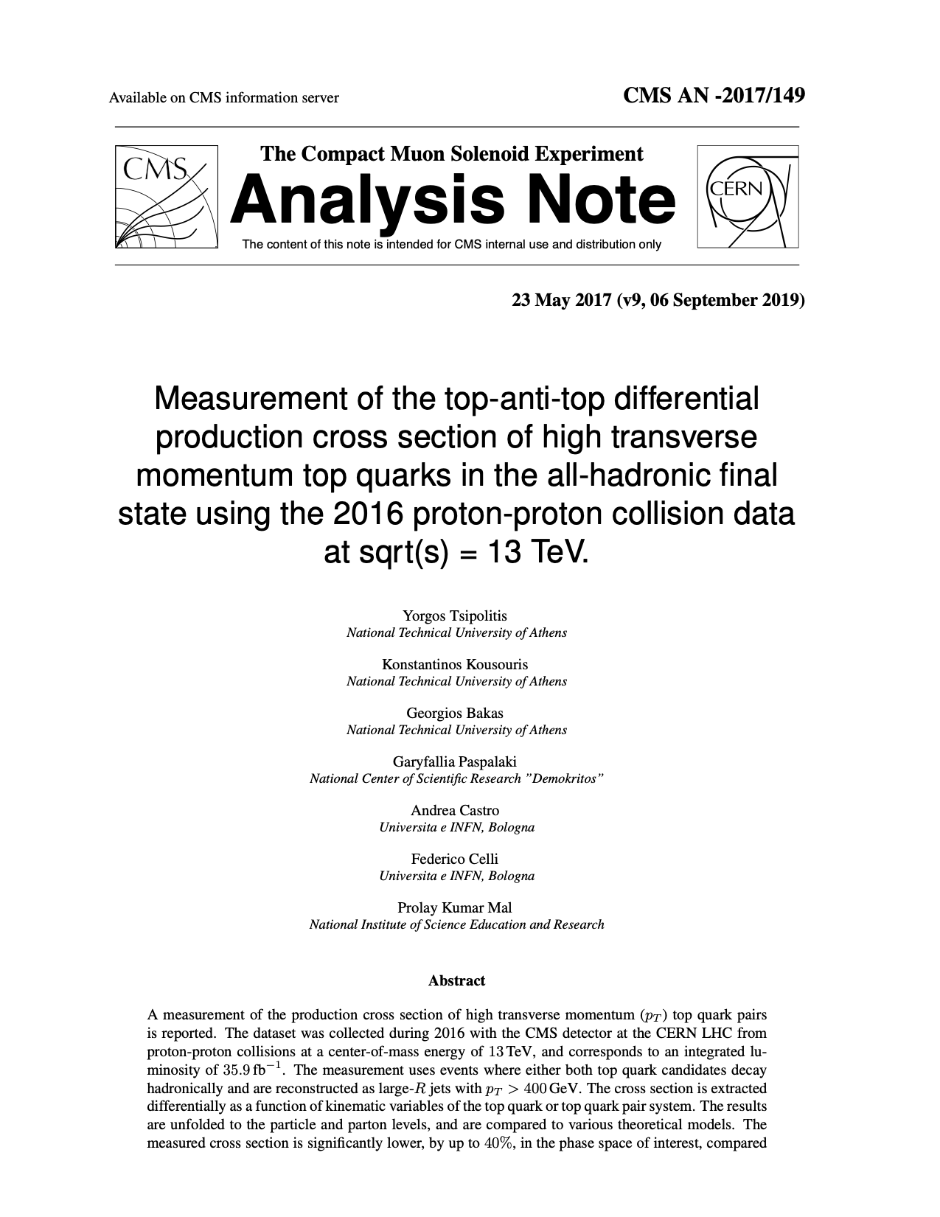


Documentation
AN-2017/149
TOP-18-013
https://twiki.cern.ch/twiki/bin/viewauth/CMS/TOP18013

Slide 3
Analysis overview
2016 dataset
very well understood (calibrations, scale factors, etc)
working on the legacy measurement with full Run II dataset but it will take ~1 year to reach same level of maturity
Trigger: two AK8 jets @ HLT and b tagging
Selection
two AK8 jets with pT > 400 GeV
“ttbar event tagging” MVA using jet substructure variables as inputs
categories based on subjet b tagging
0-btag: control
2-btag: signal
Backgrounds
QCD dominant: taken from data
others (ST, W/Z+jets): negligible
Deliverables
differential cross sections
seven observables:leading & subleading top pT & |y|, ttbar system mass, pT & rapidity
unfolded to parton level, unfolded to particle level

Slide 4
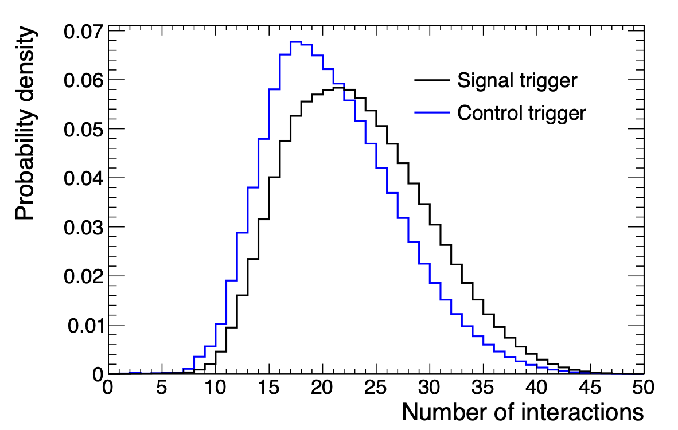
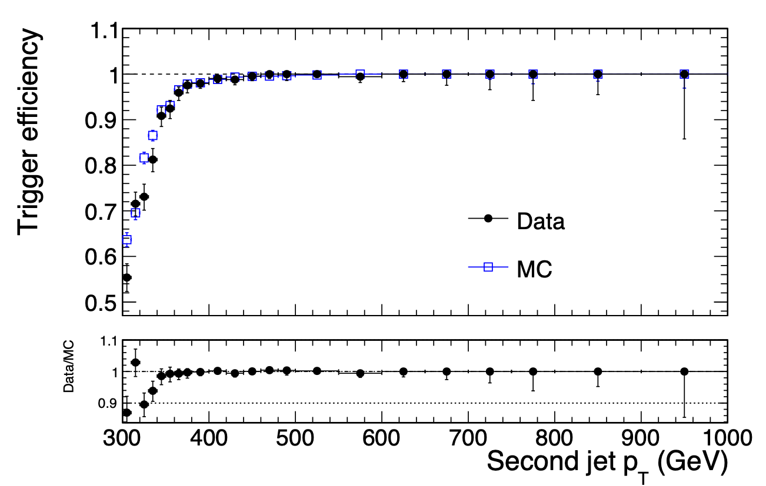
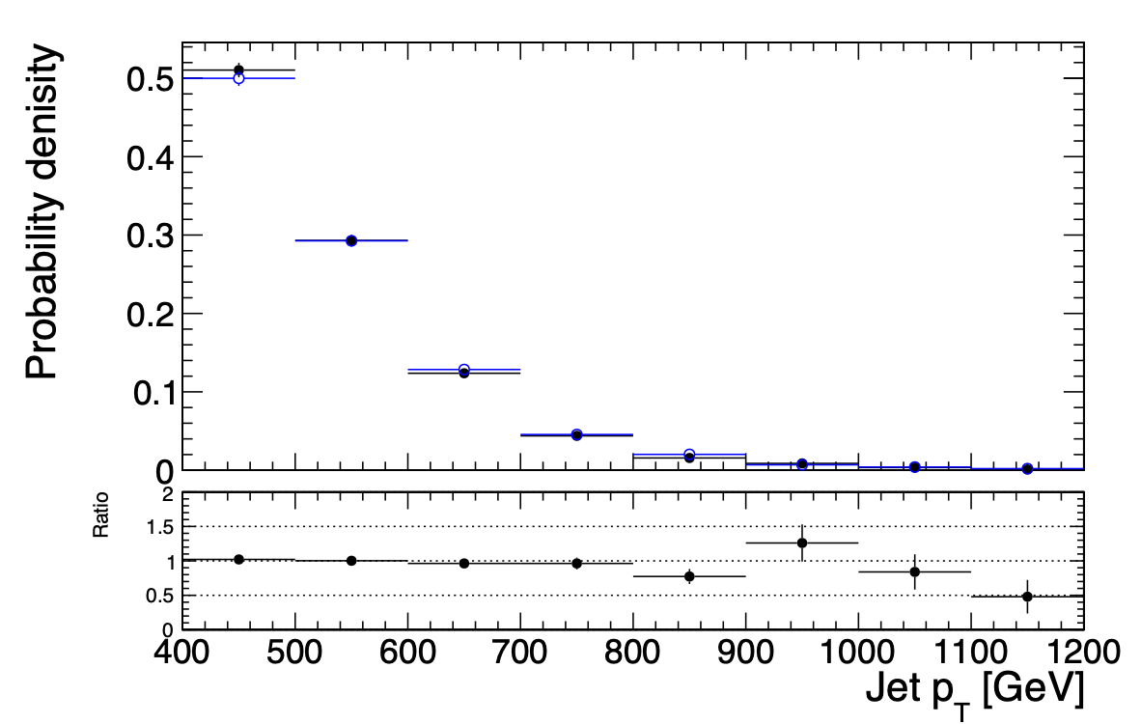
Trigger
Signal path: HLT_AK8DiPFJet280_200_TrimMass30_BTagCSV_p20
unprescaled: 35.9 fb⁻¹ luminosity
efficiency measured wrt orthogonal muon trigger
Control path: HLT_AK8DiPFJet280_200_TrimMass30
same kinematics, no HLT b tagging
prescaled: 1.67 fb⁻¹ luminosity
somewhat lower pileup profile (analysis not sensitive to pileup)
Analysis region

Slide 5
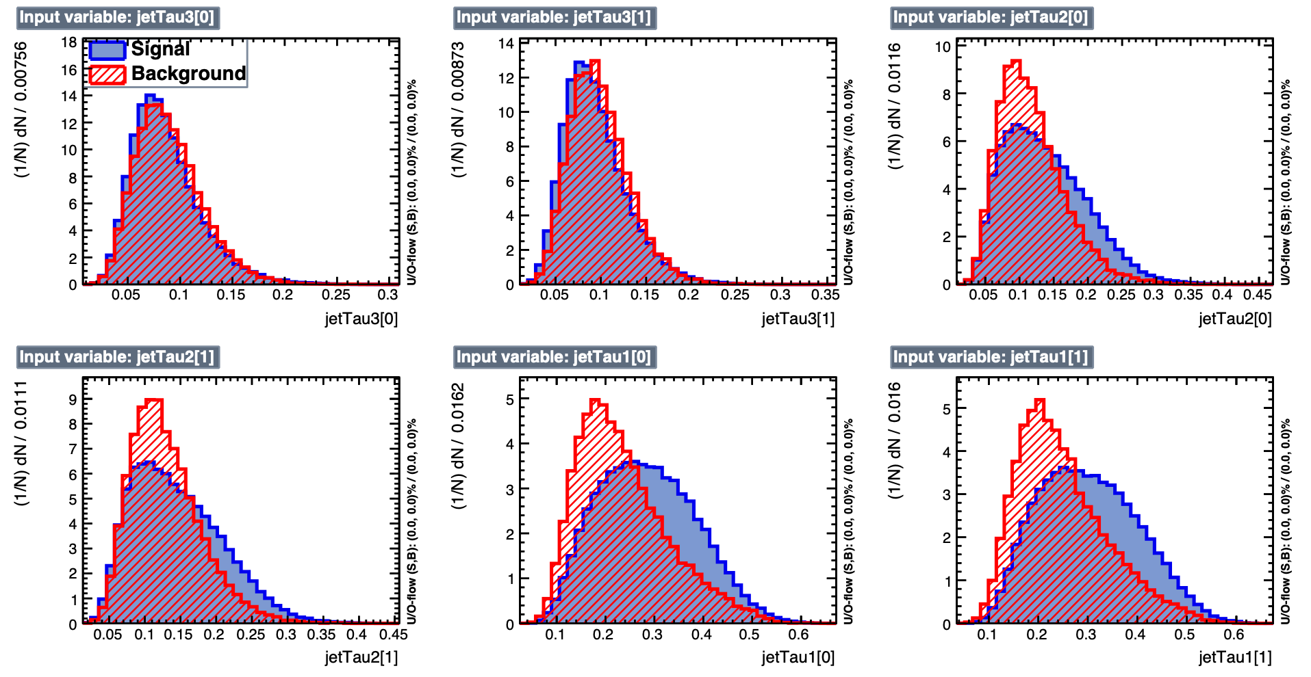
Multivariate discriminant (variables)
“ttbar tagger”
N-subjettiness τ1,2,3 for both jets

Slide 6
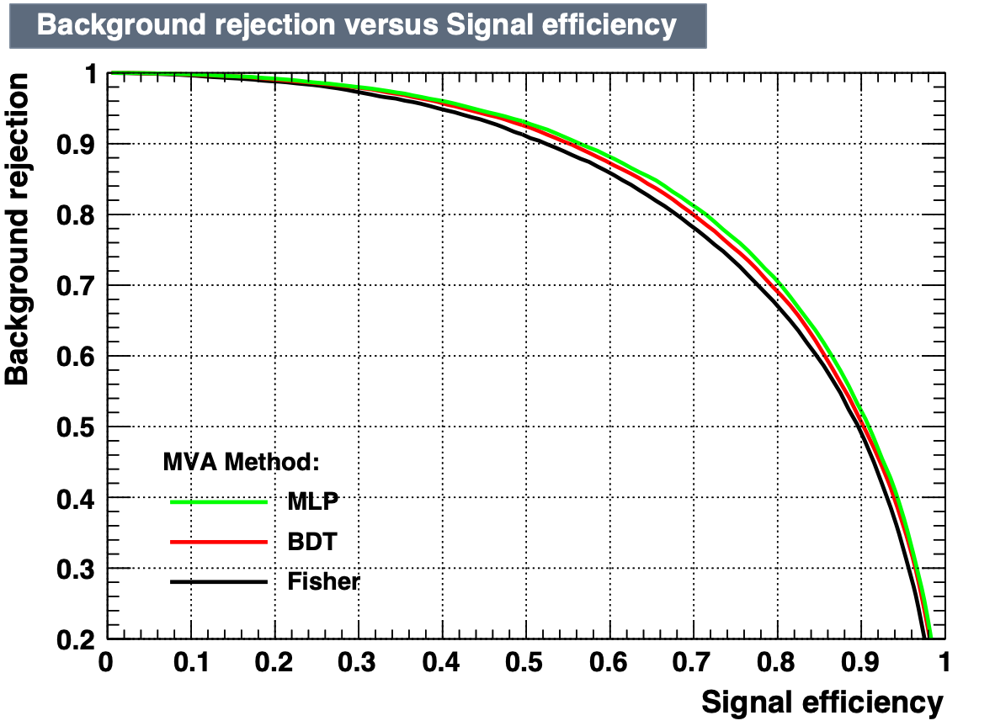
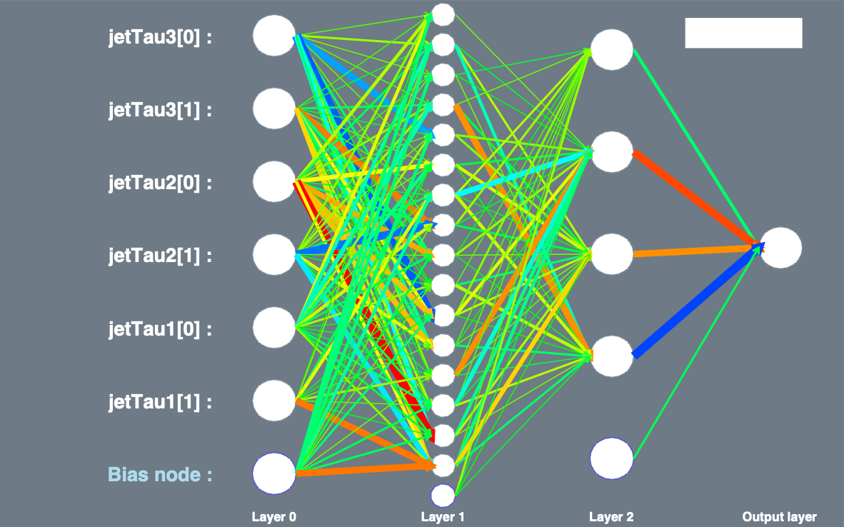
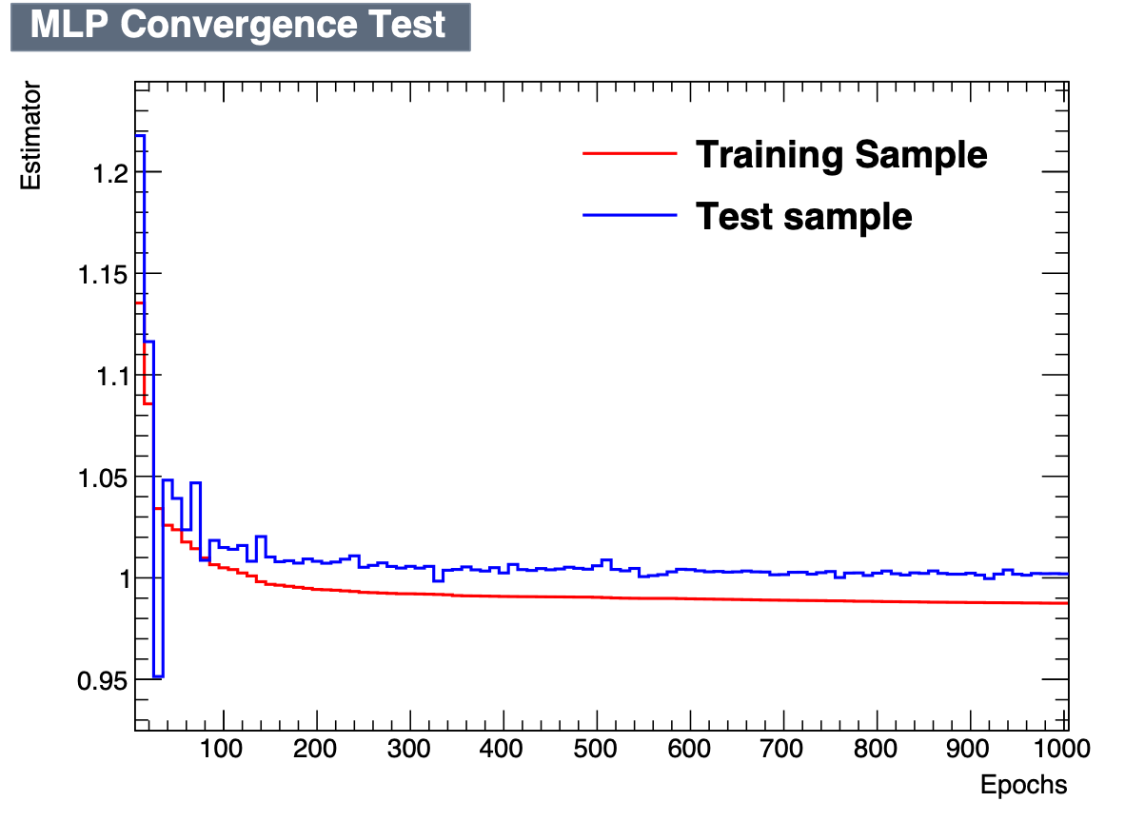
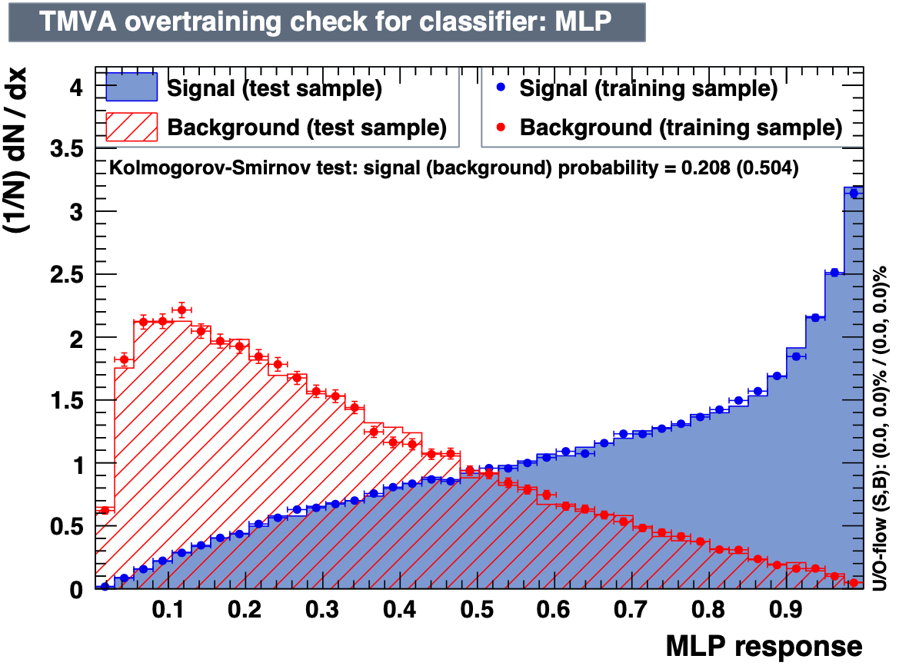

Multivariate discriminant (training)
CUT

Slide 7
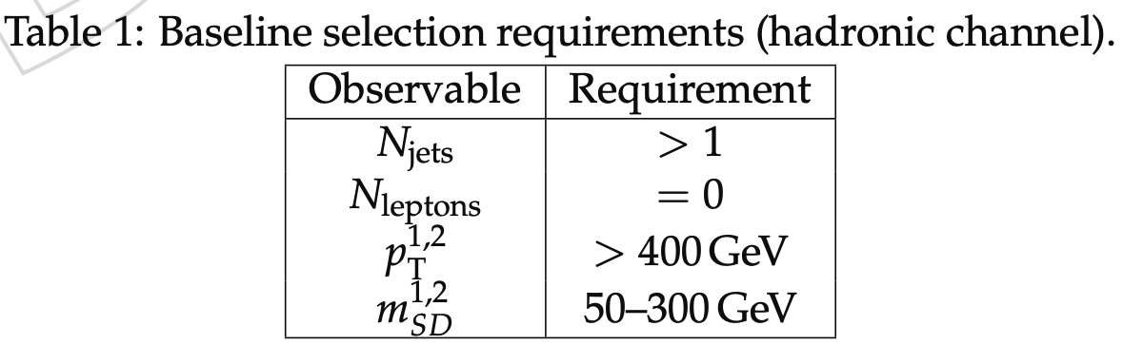
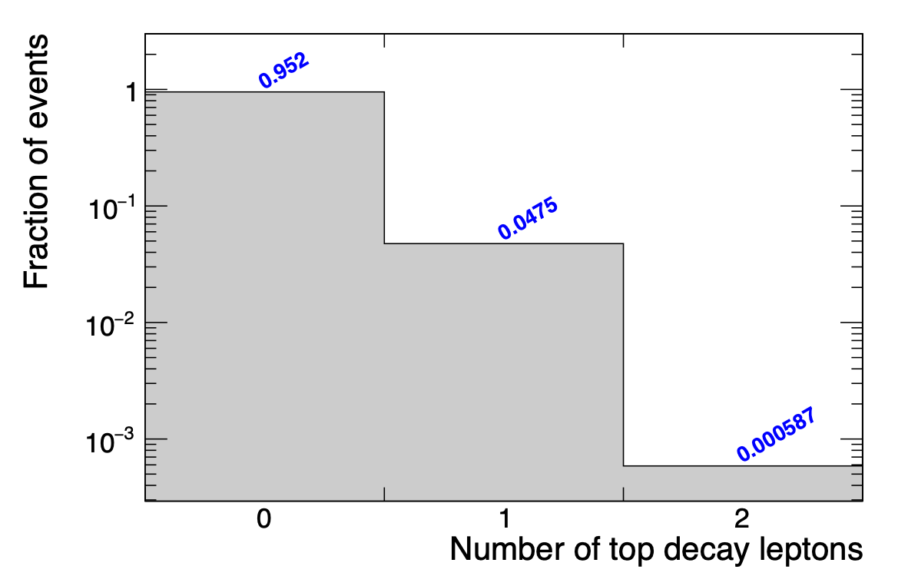


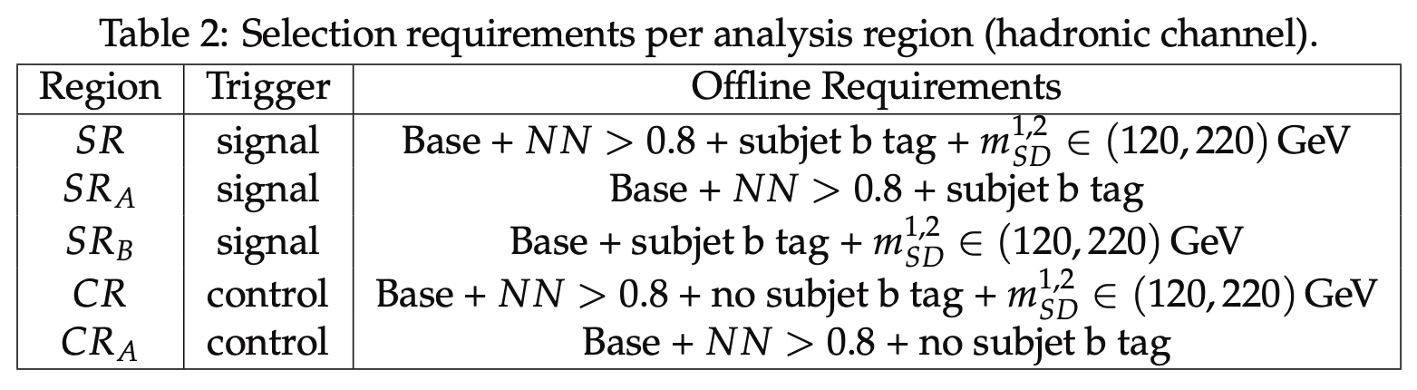
Selection
jets: AK8 PF+CHS
signal region: 95% hadronic decays
NN CUT (0.8)
compromise between enough tt events and signal purity

Slide 8
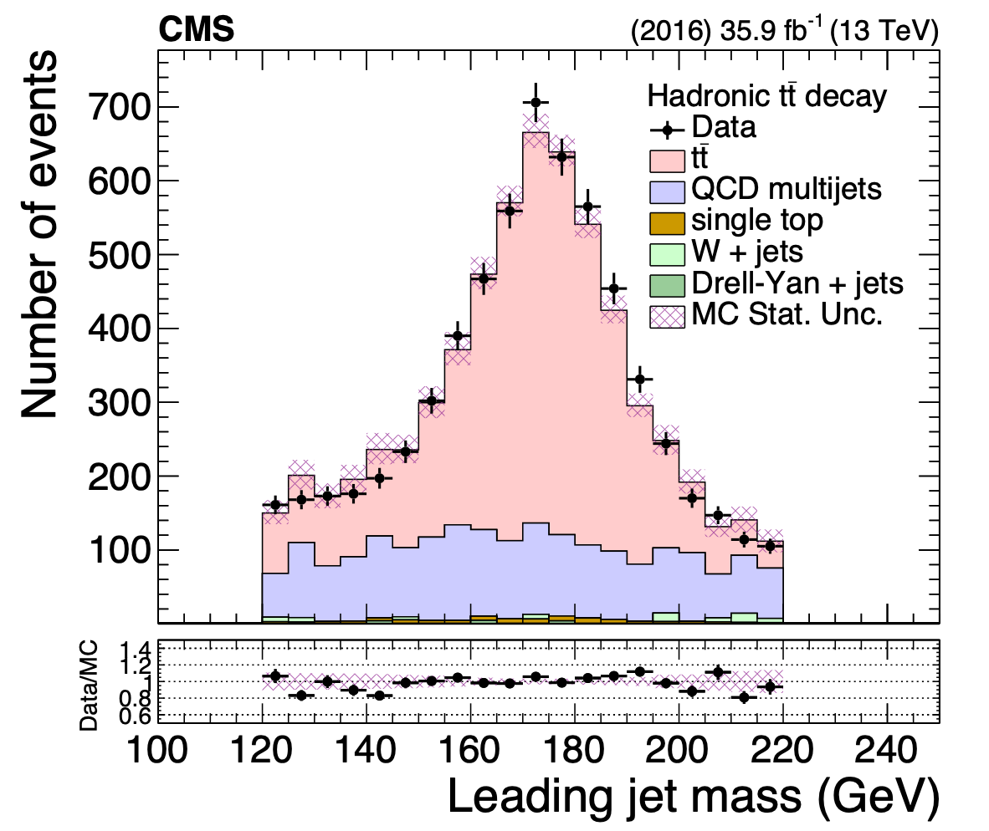
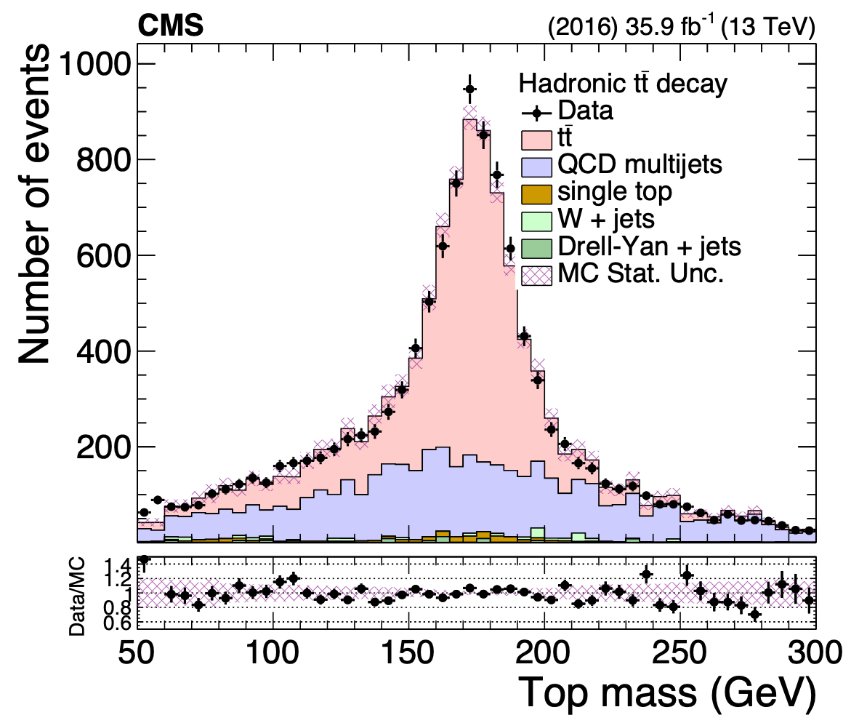
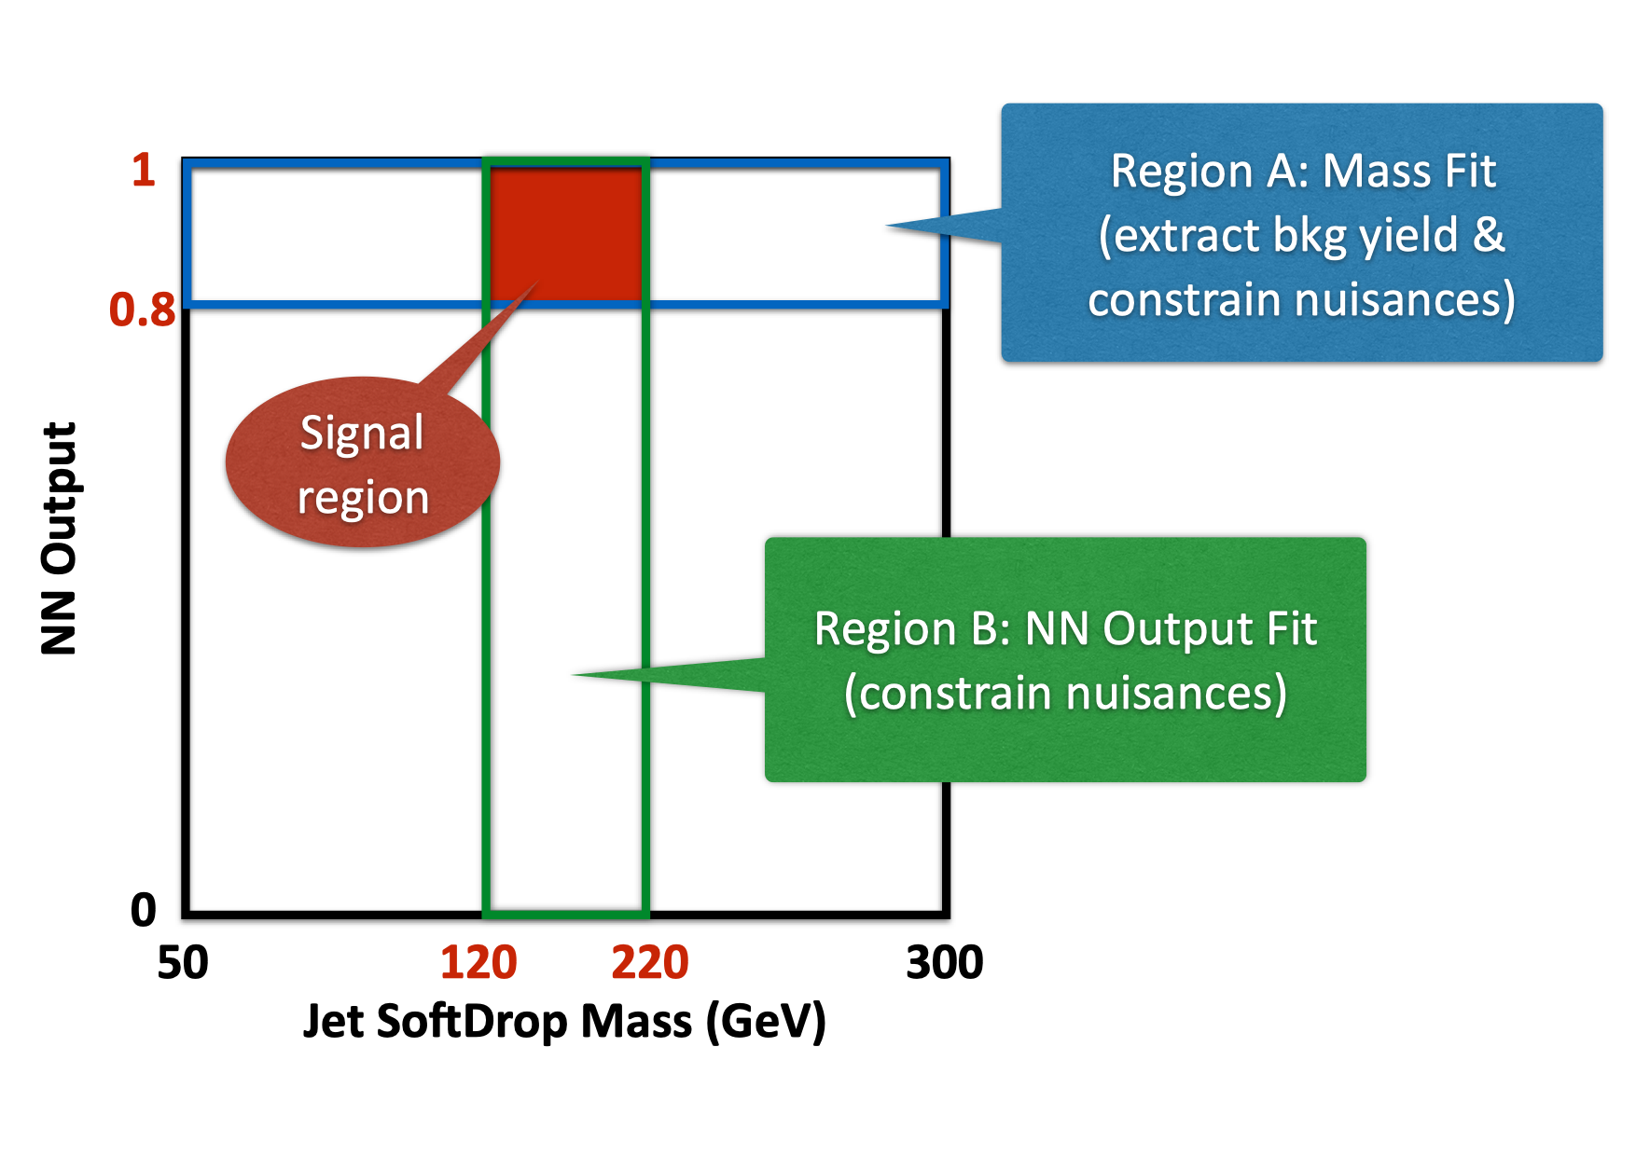
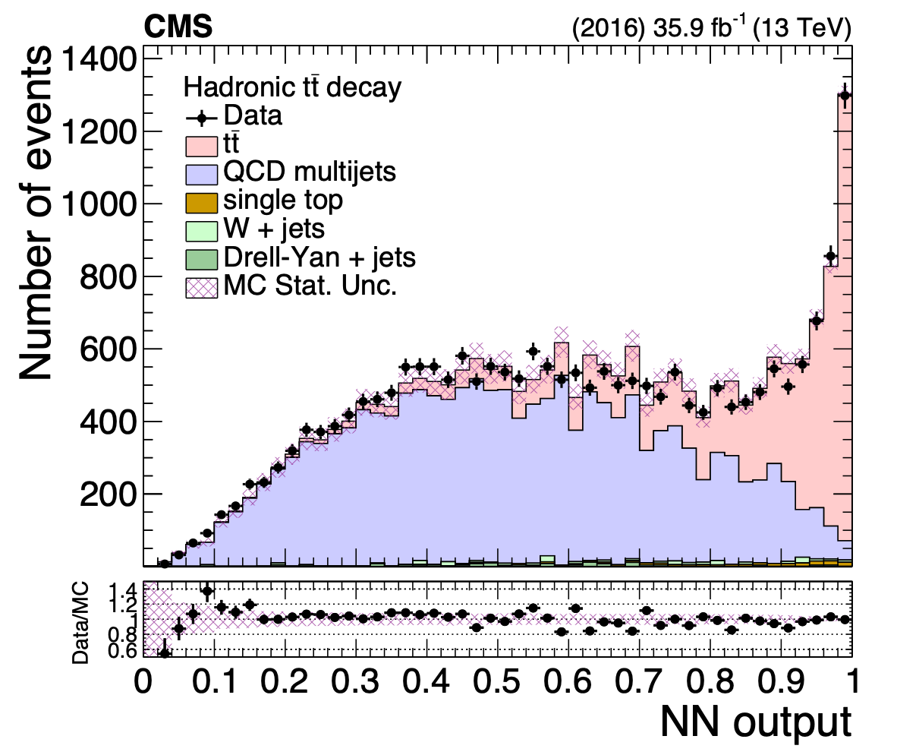
Analysis regions
paper

Slide 9
Signal extraction
fiducial yield
Data
Transfer factor from SRA to SR (taken from CRA/CR data)
Bkg shape
(taken from CR in data)
Bkg yield
(fit in region SRA)
Bkg shape correction
(taken from MC)

Slide 10
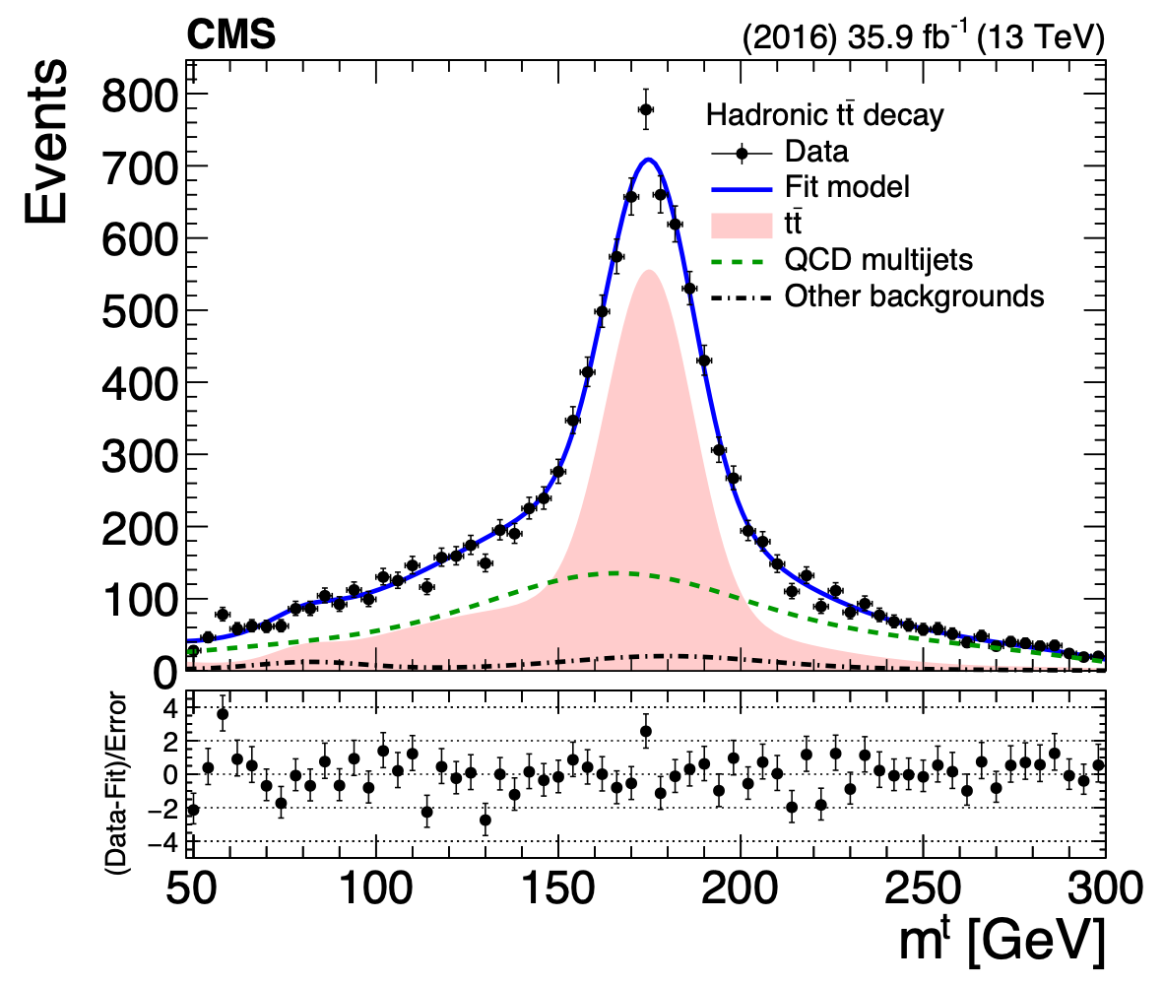
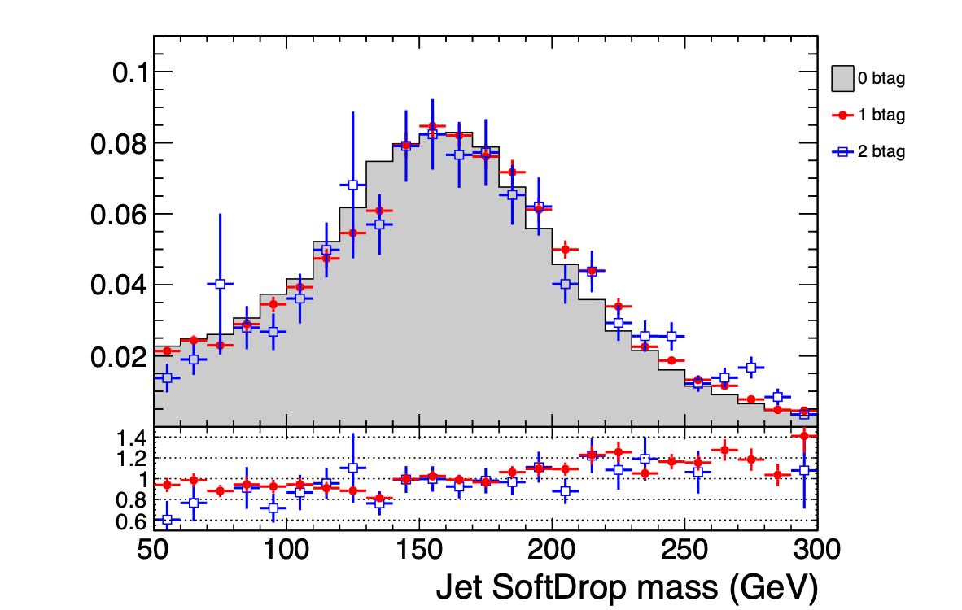
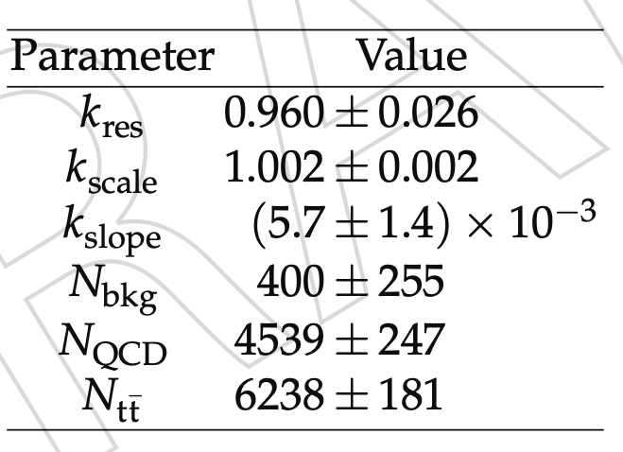
Fit in SRA
MC QCD closure
paper
Process | SRA (pre-fit) | SRA (post-fit) | SR (pre-fit) | SR (corrected)
ttbar | 9853 | 6238 | 6685 | 4245
QCD | 5346 | 4539 | 2248 | 1876
single top | 215 | 215 | 83 | 83
VJets | 185 | 185 | 71 | 71
Data | 11145 |  | 6274
rtt = 0.63

Slide 11
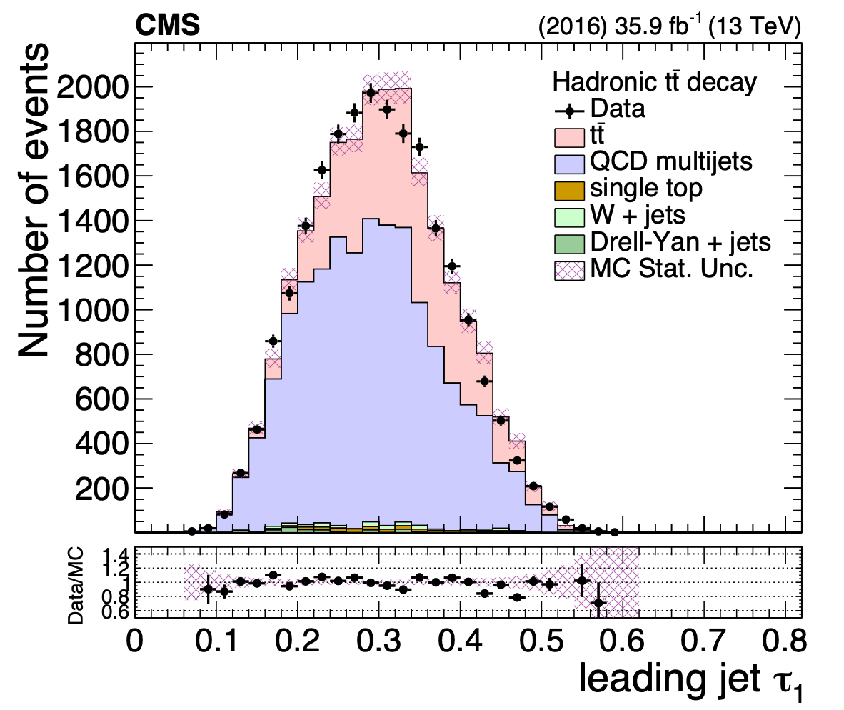
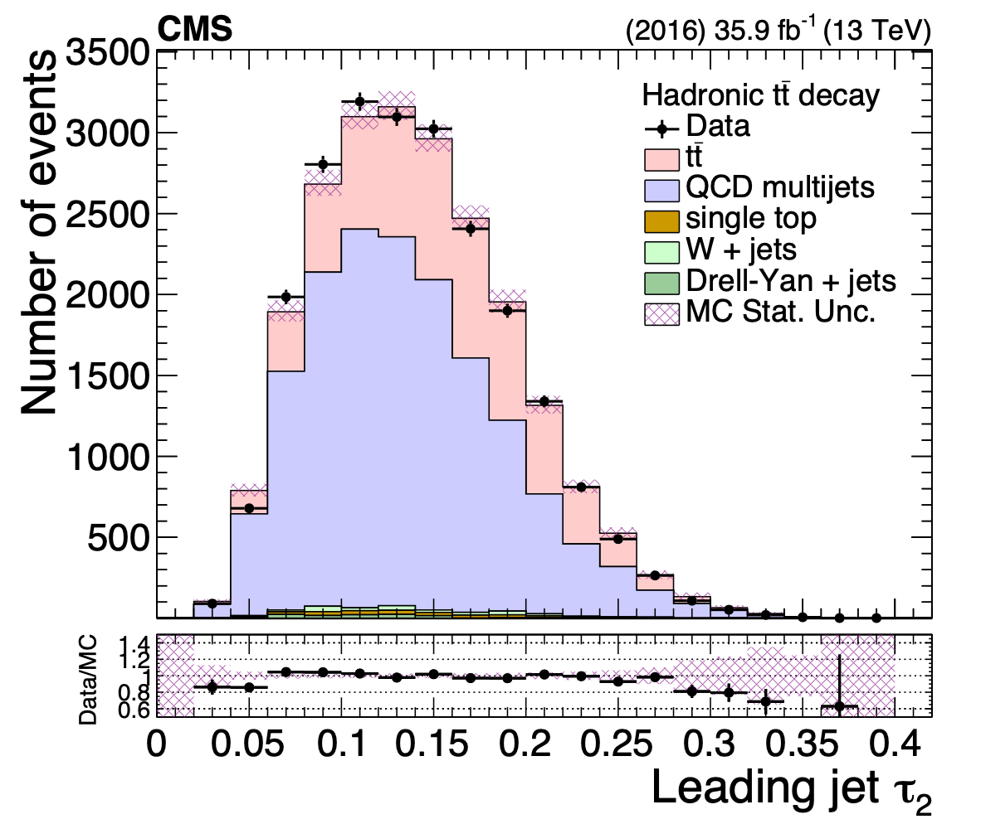
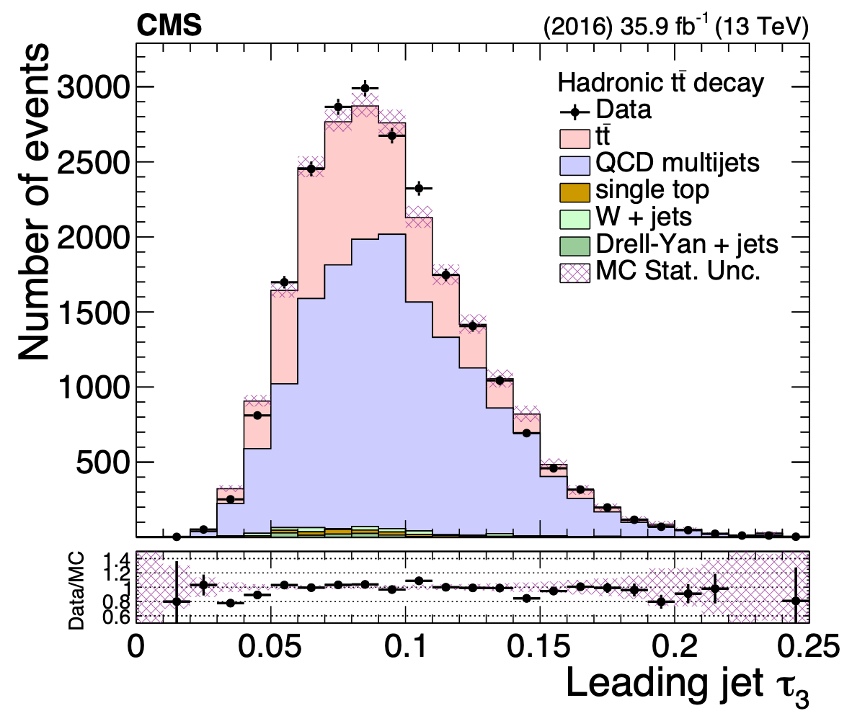
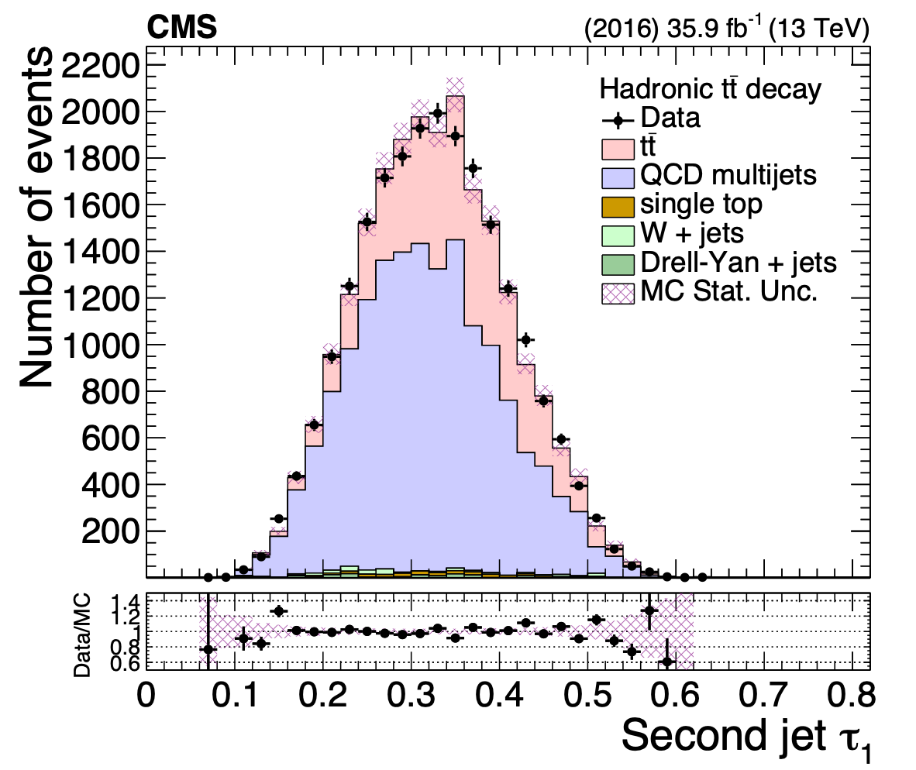
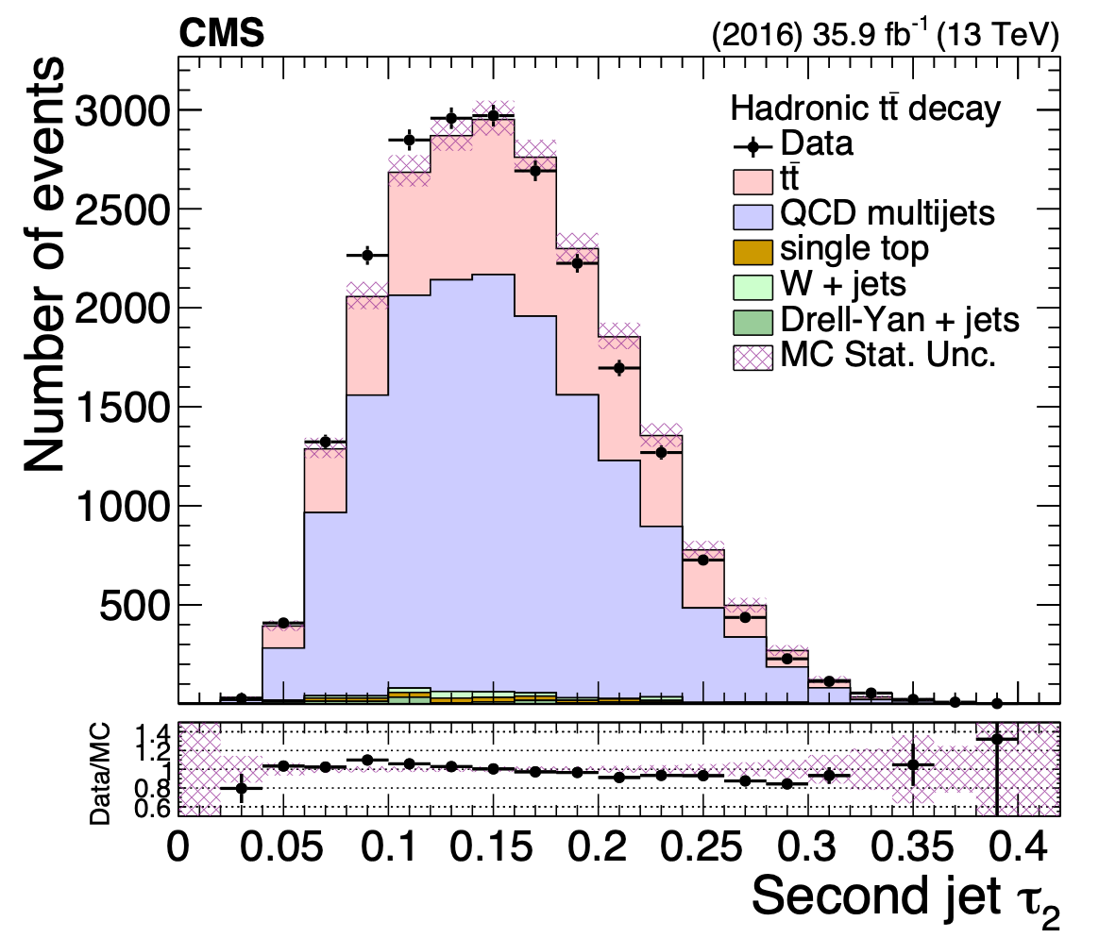
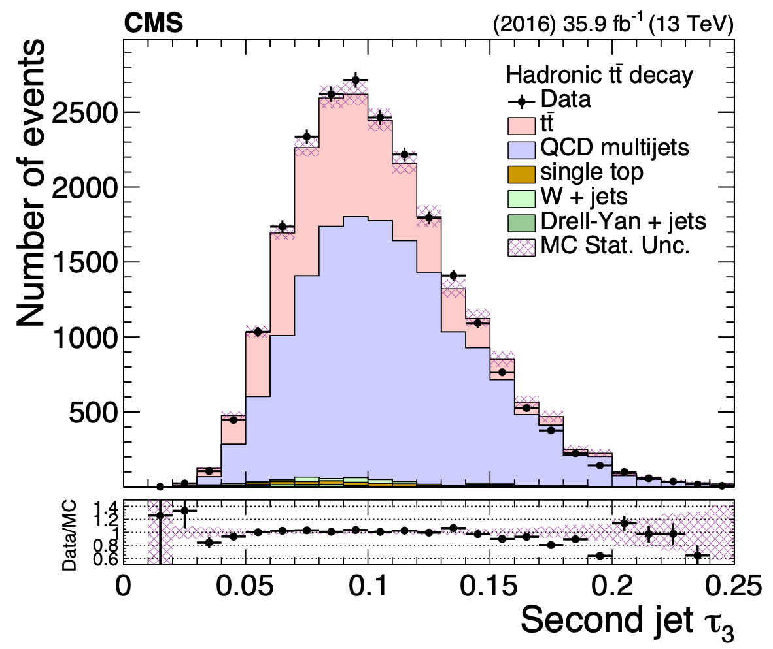
Substructure properties (before NN cut)

Slide 12
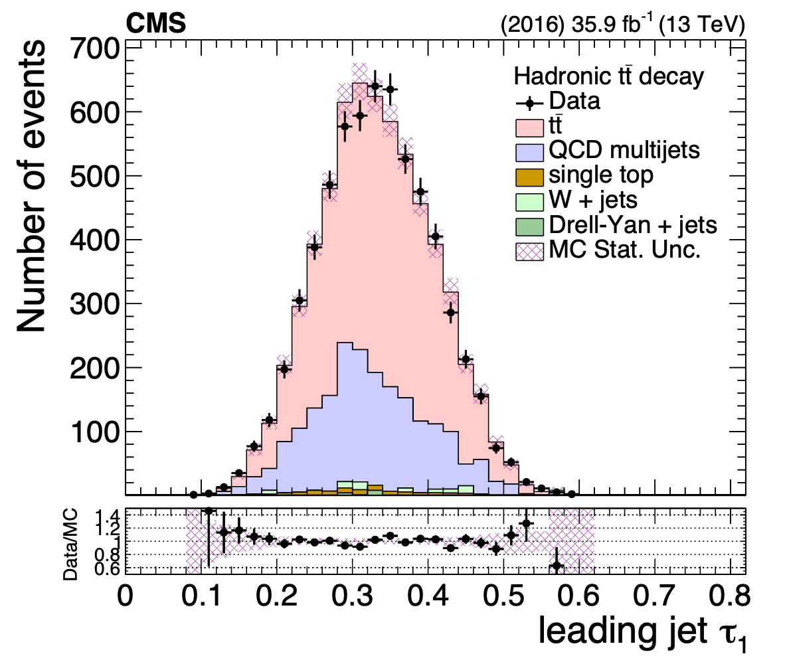
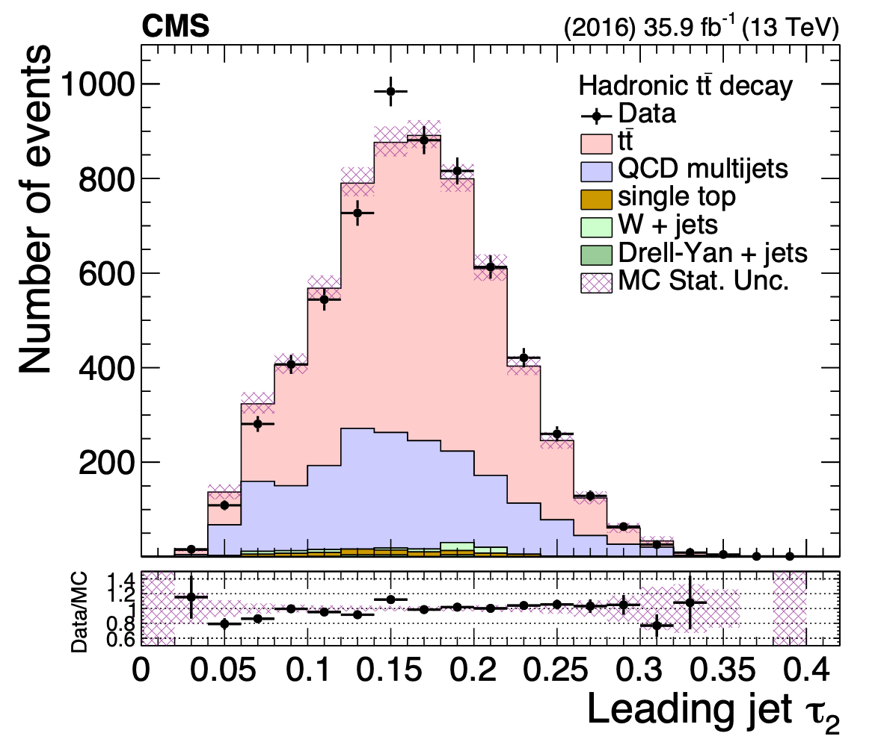
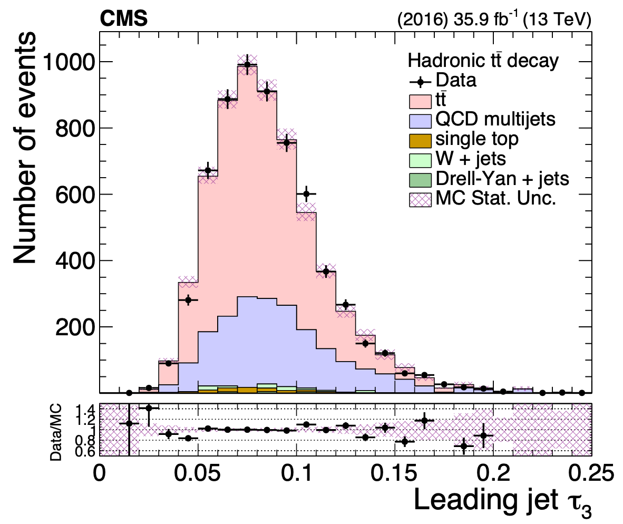
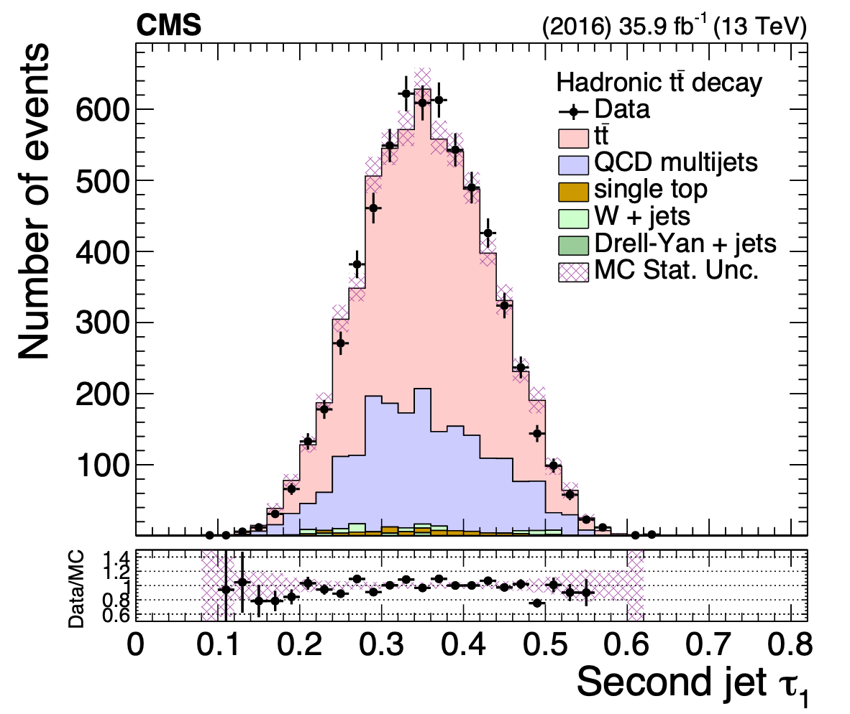
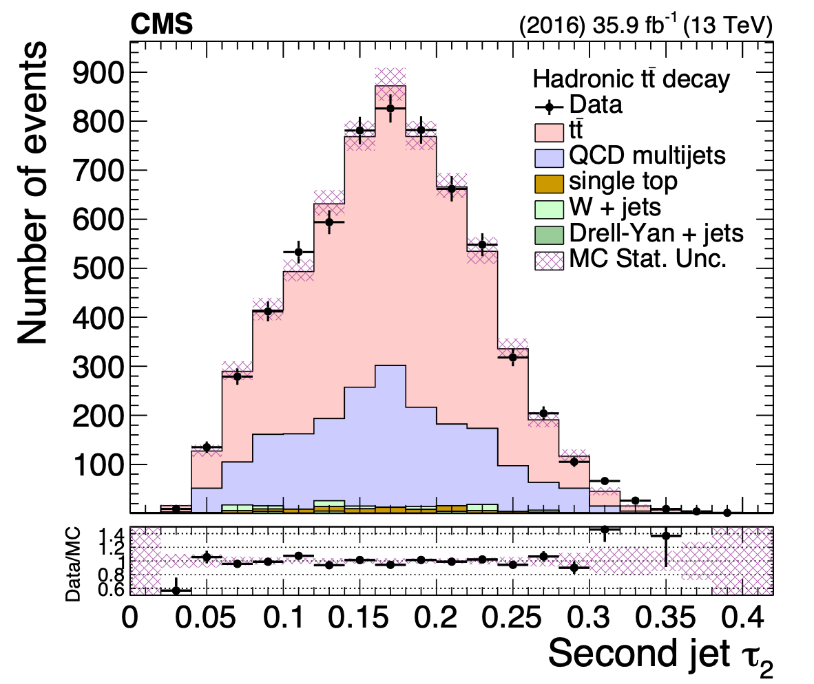
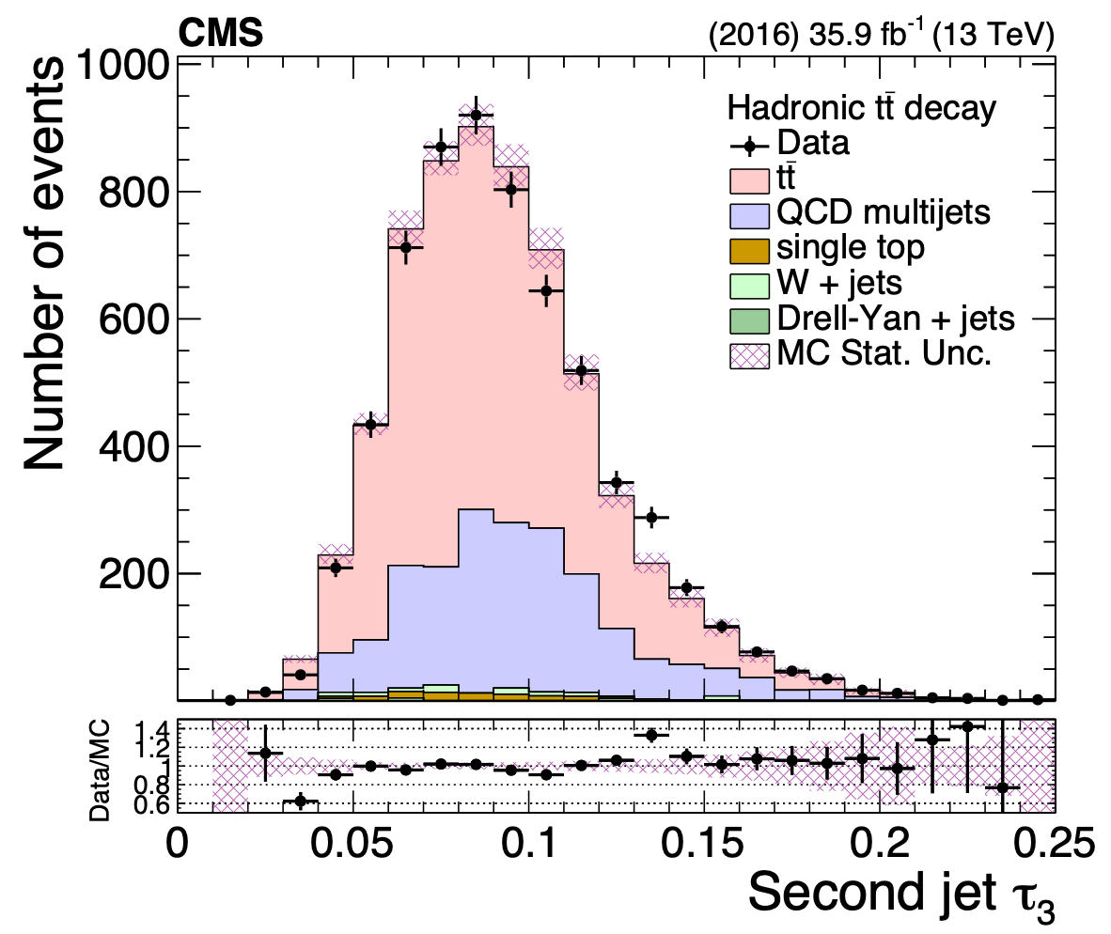
Substructure properties (after NN cut)

Slide 13
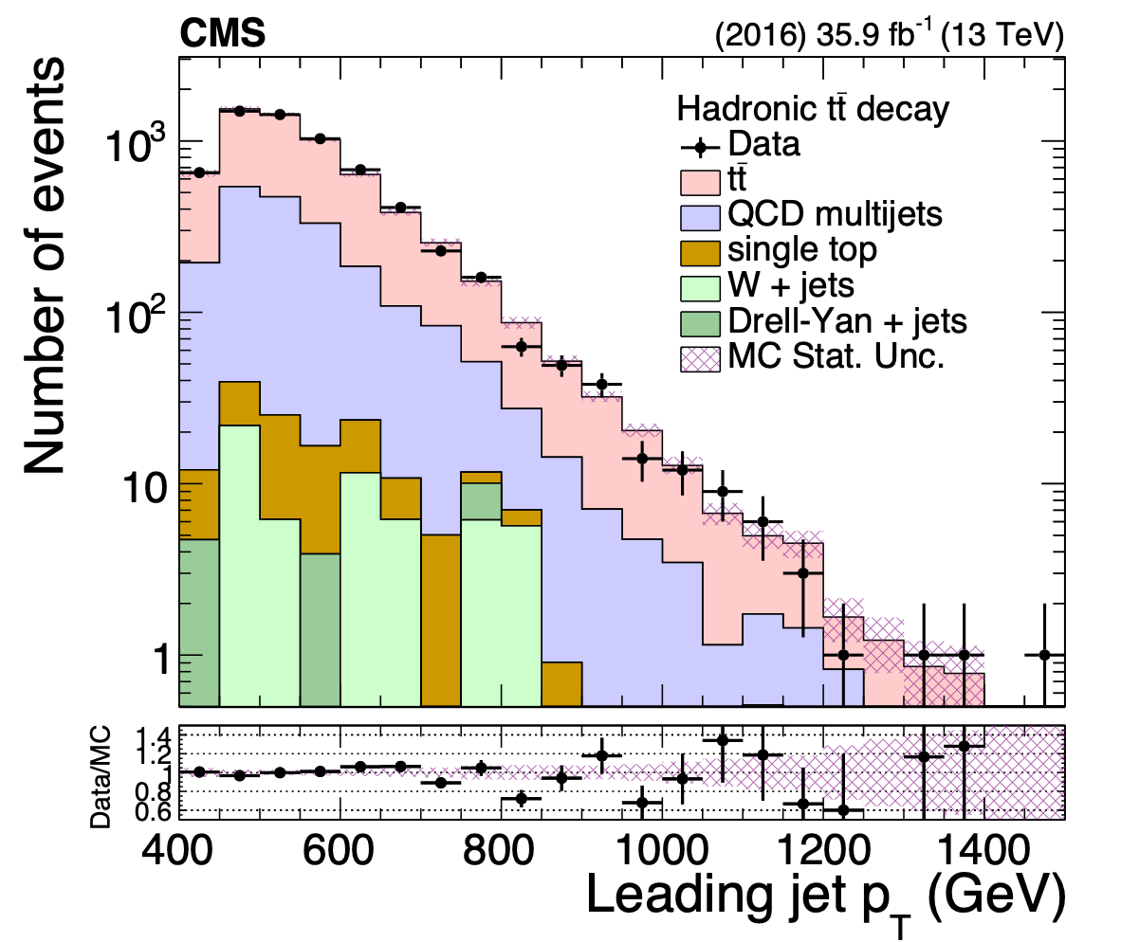
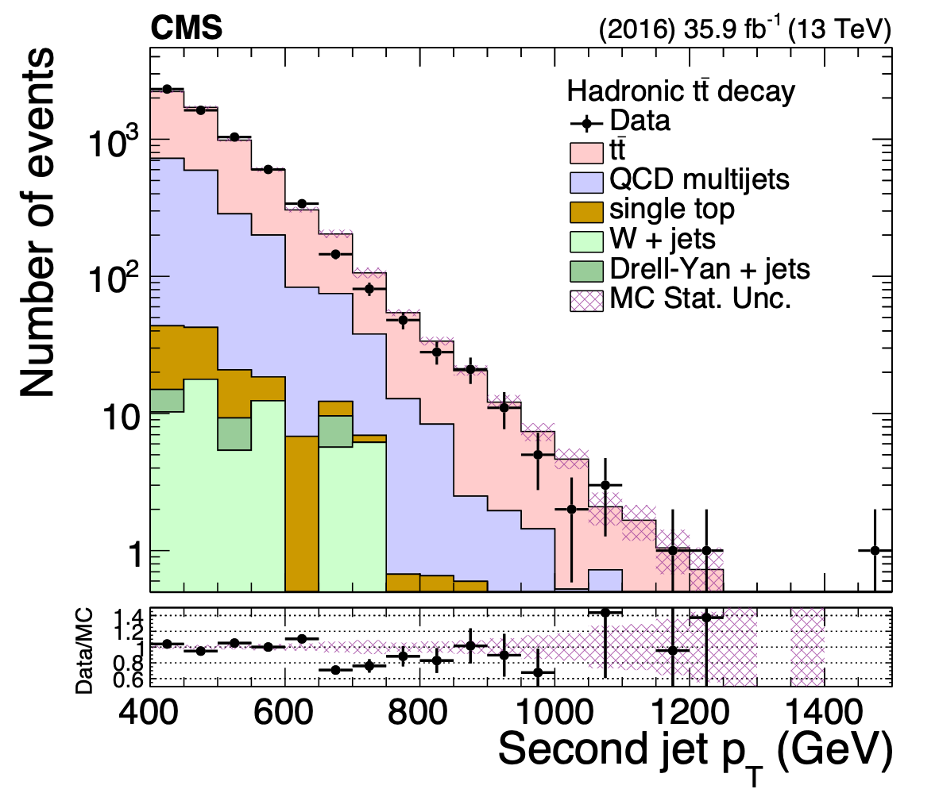
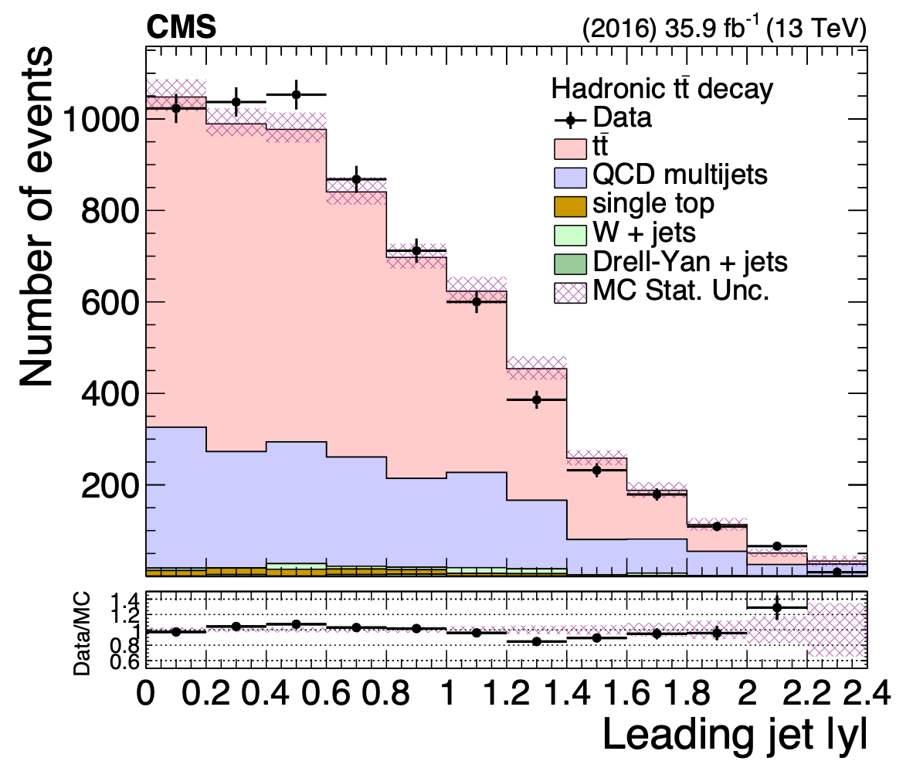
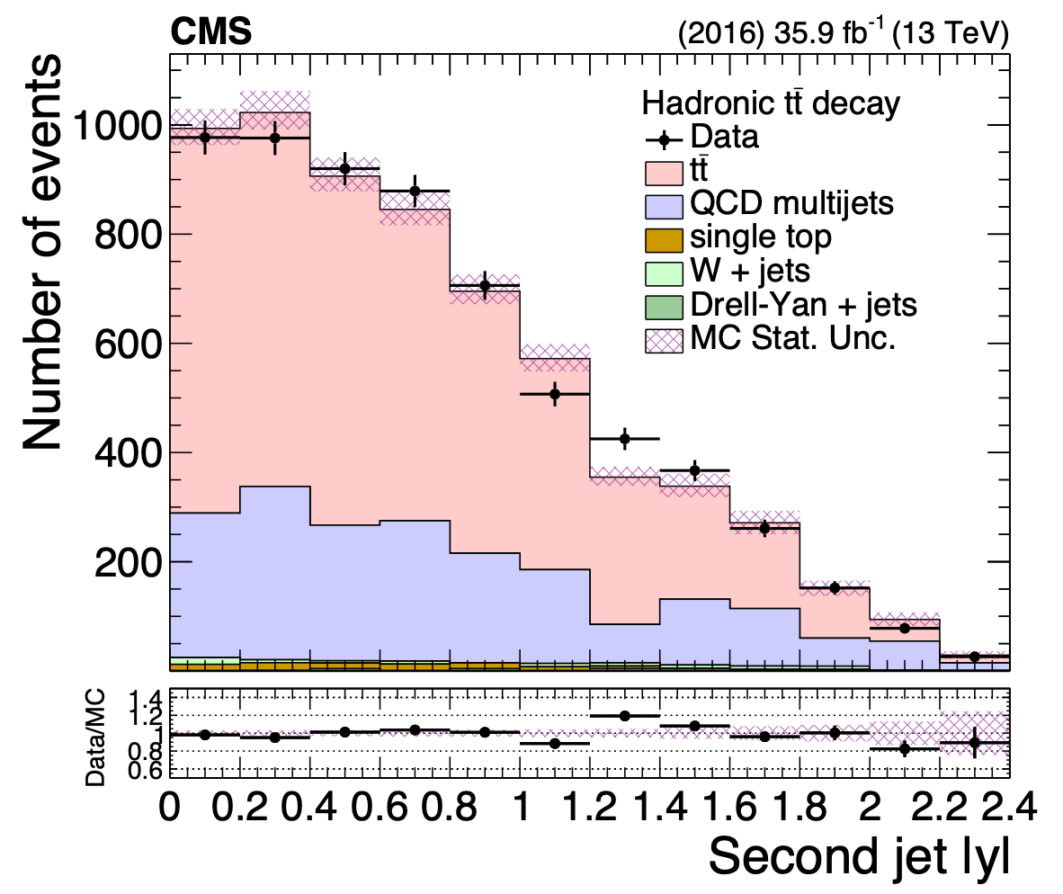
Top kinematic variables

Slide 14
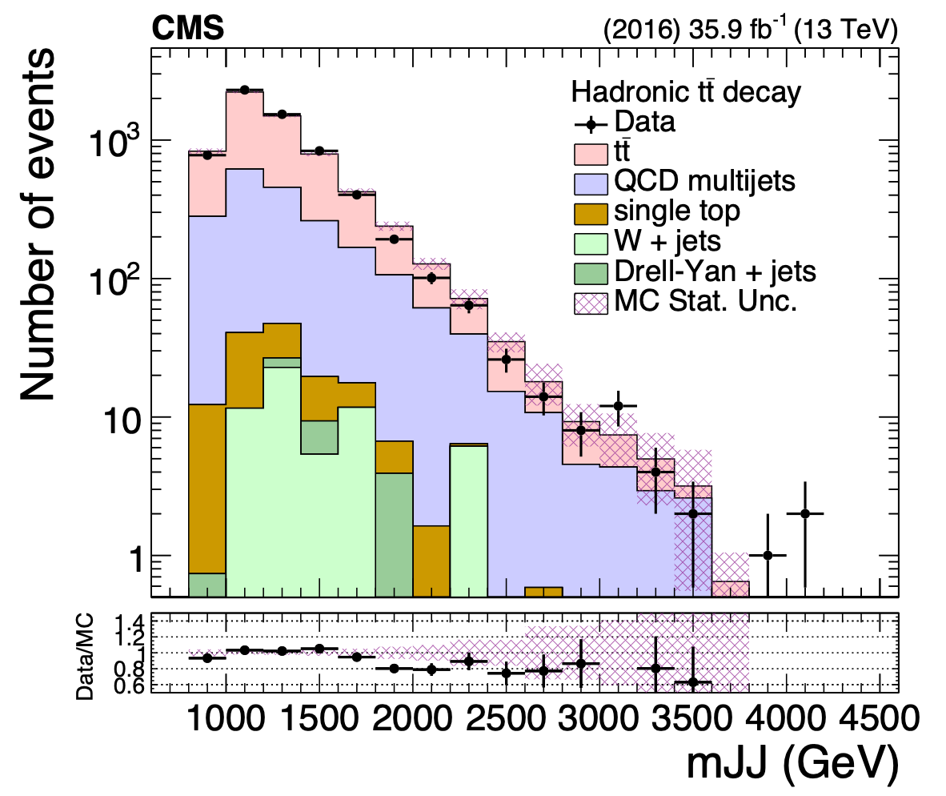
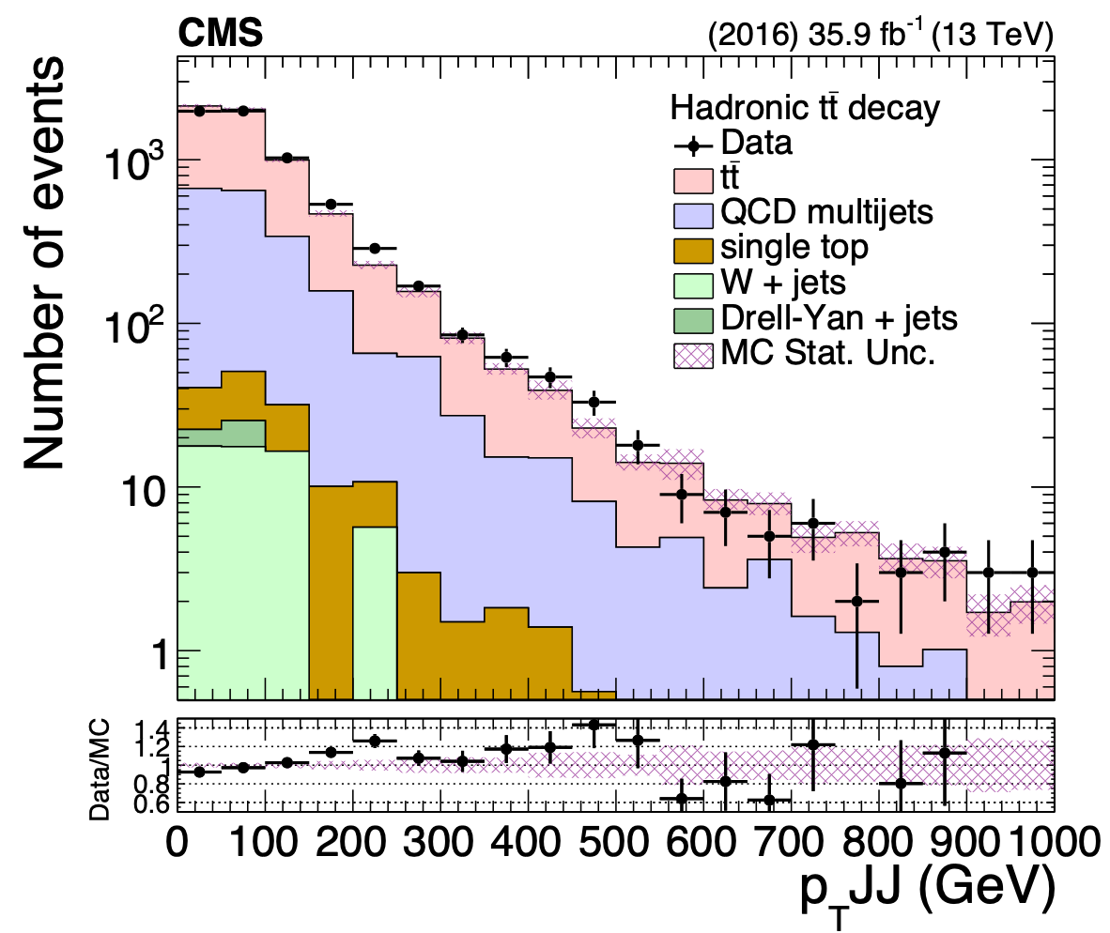
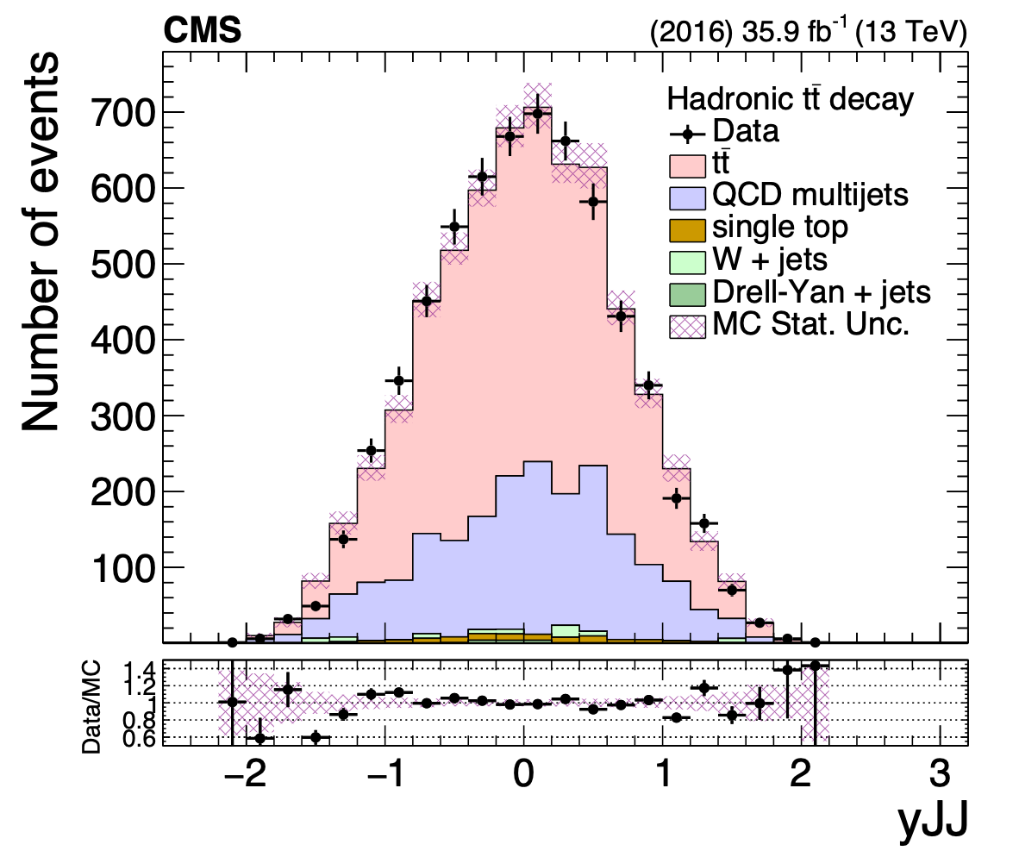
Top kinematic variables

Slide 15
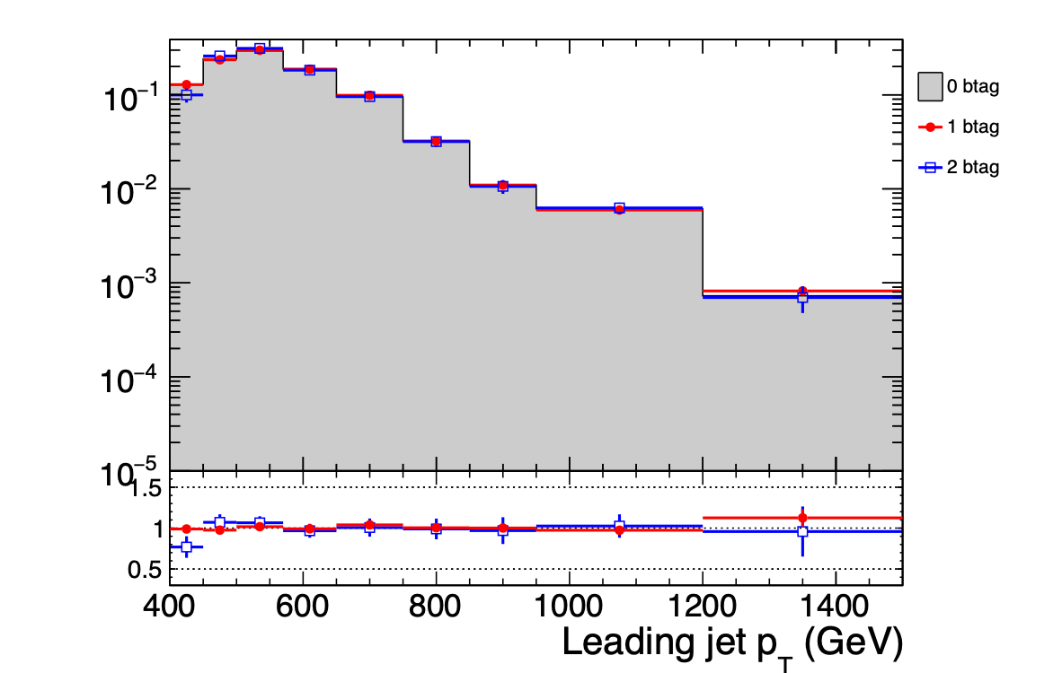
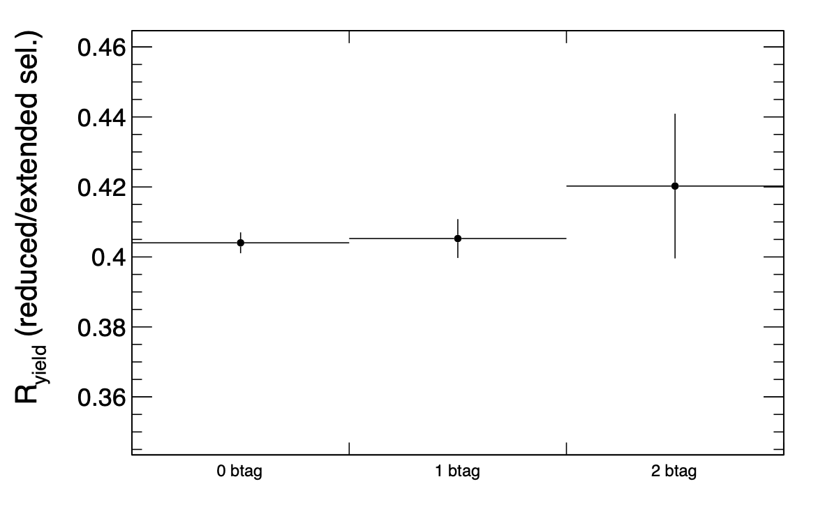
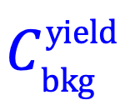
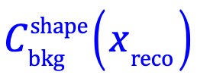
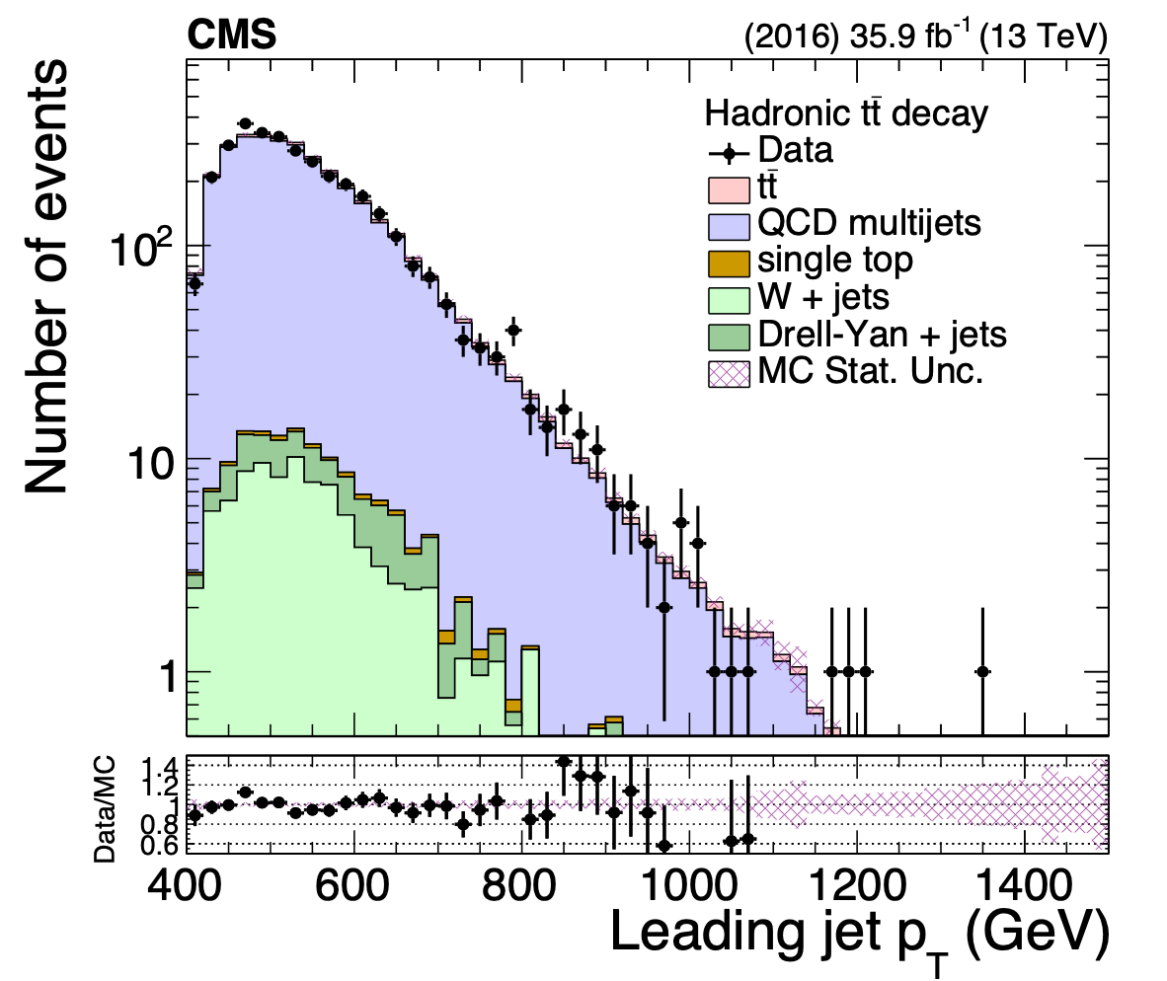
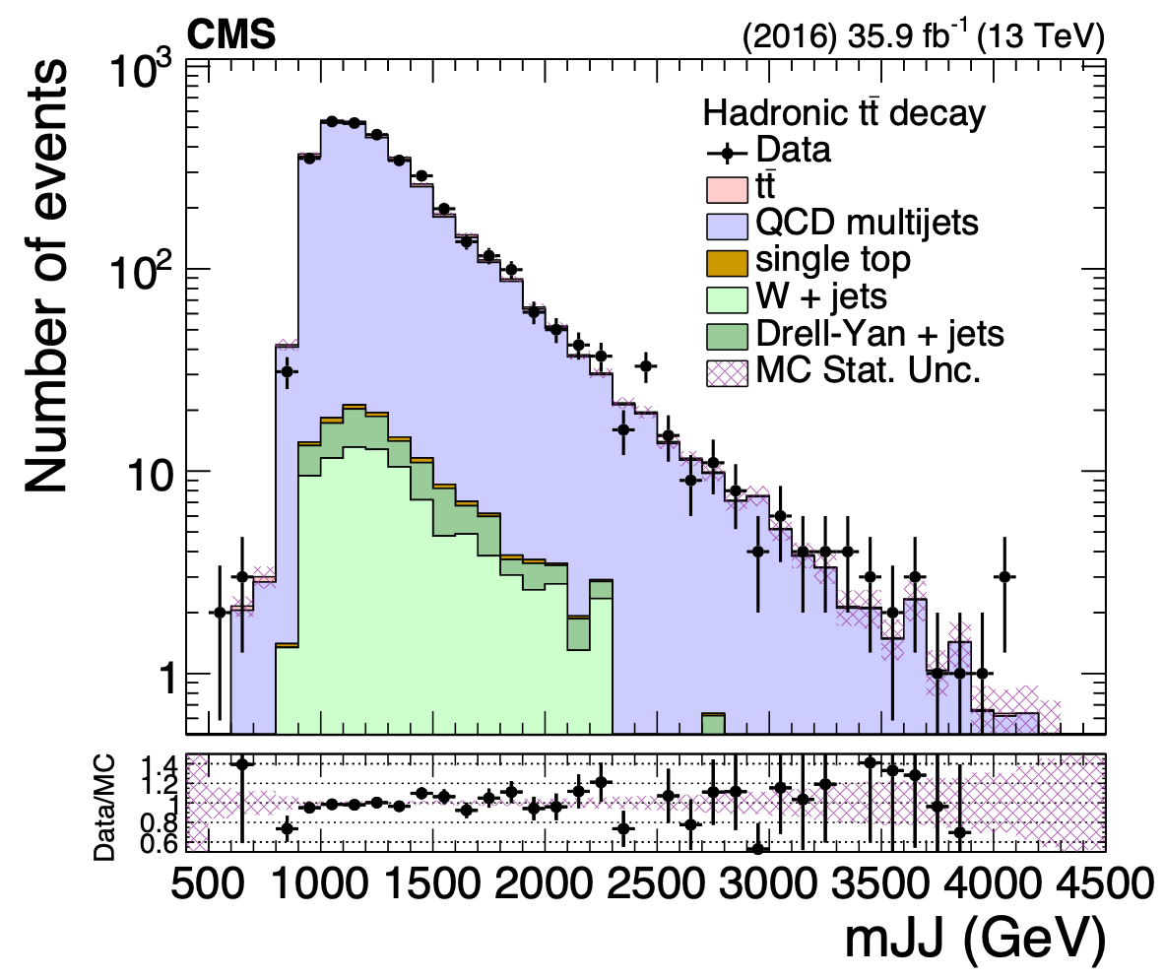
Validation of the background method
QCD MC
QCD MC
Negligible signal
contamination in 0-btag

Slide 16
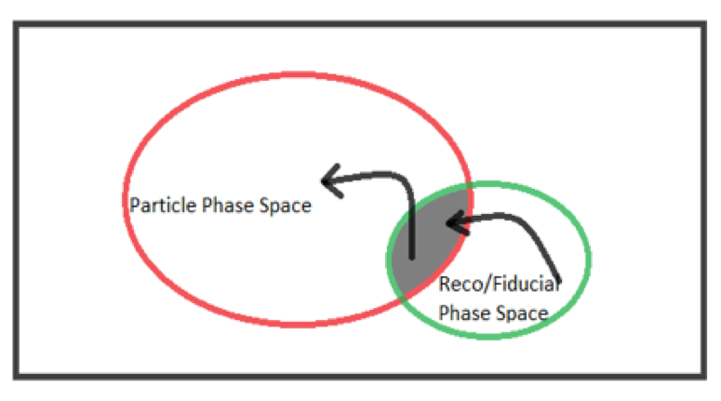
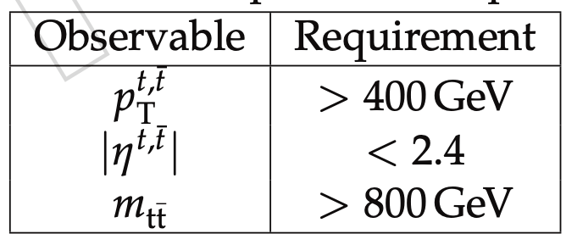
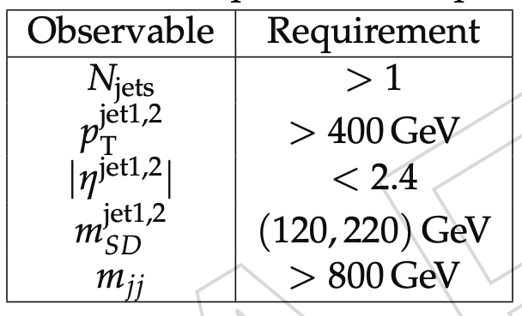
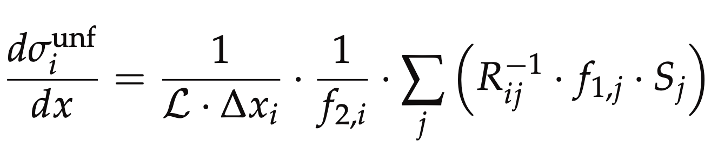
Parton & Particle levels
Particle
top candidates: AK8 genjets
Parton
migration matrix
reco efficiency of the reco+true selection
efficiency of the reco+true selection
Unfolding: simple response matrix inversion w/o regularisation

Slide 17
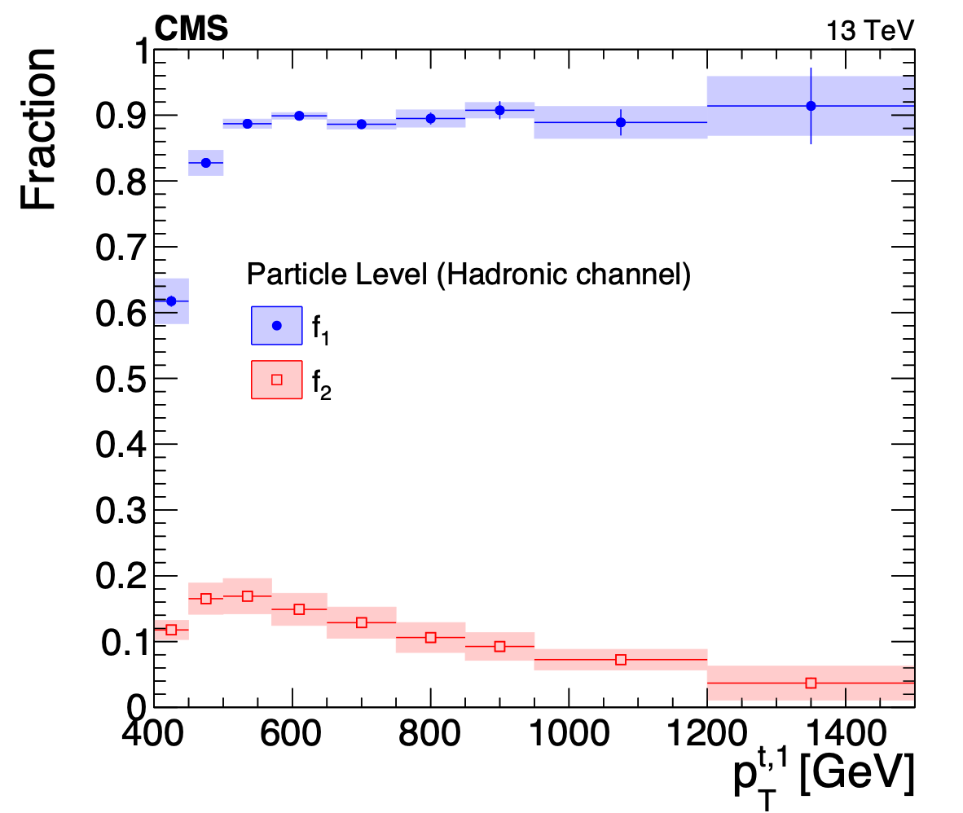
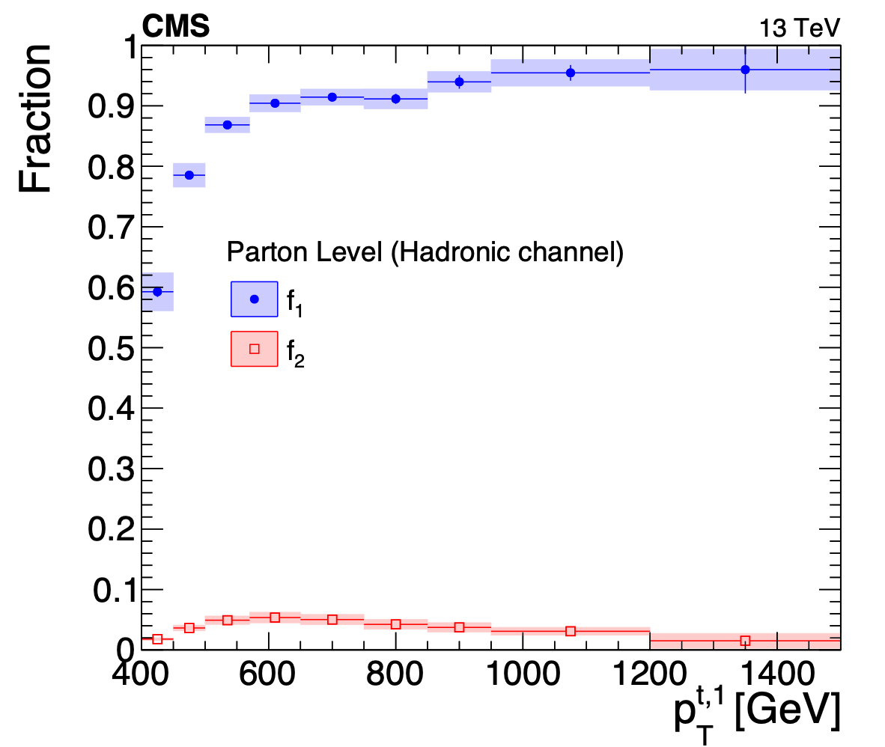



Fractions of particle & parton level definitions
f1: fraction of reco events in the reco+parton/particle phase space
f2: fraction of parton/particle events in the reco+parton/particle phase space
paper
paper
Particle to parton matching efficiency

Slide 18




Migration matrices
paper

Slide 19
Systematic uncertainties
Two categories:
Experimental: object performance between data and simulation
Theoretical: related to the simulation itself(acceptance, efficiency, migration matrix)
Experimental
QCD bkg prediction
Jet Energy Scale
Jet Energy Resolution
Subjet b-tagging efficiency
Pileup
Trigger
Luminosity
Theoretical: Divided into 2 groups
Matrix element of the hard process (variations of LHE event weights stored in nominal MC)
Modelling of the parton shower and the underlying event (dedicated, alternative MC samples)
Parton Distribution Functions
Renormalisation and factorisation scales:
Strong coupling constant
Final State Radiation (FSR): in situ constrained
Initial State Radiation (ISR)
Matrix Element-Parton showering matching
Underlying event tune

Slide 20




In situ constraint of the FSR uncertainty
Template fits with Combine
Fit suggests scale down with 0.25, we use 0.3

Slide 21




Uncertainties vs leading top pT
paper

Slide 22




Uncertainties vs leading top |y|
paper

Slide 23




Results (parton, top pT)
paper

Slide 24




Results (particle, top pT)
paper

Slide 25




Results (parton, top |y|)
paper

Slide 26




Results (particle, top |y|)
paper

Slide 27






Results (parton, mtt, ytt, pT,tt)
paper

Slide 28






Results (particle, mtt, ytt, pT,tt)
paper

Slide 29
Summary
we have performed a measurement of differential ttbar cross section with boosted top quarks in the hadronic channel
2016 data, 35.9 fb⁻¹
highest reach so far: 1.5 TeV in top pT and 4 TeV in mtt
seven observables: leading & subleading top pT & |y|, mtt, pt,TT, yTT
parton & particle level
absolute & normalised cross sections
results
comparison with MC models: Powheg+Pythia8, Powheg+Herwig++, aMC@NLO+Pythia8
awaiting for NNLO calculations
shapes overall compatible with theory
no top pT slope
overall shift of the order of 40% in the total cross section (Powheg+Pythia8 shows the largest discrepancy)
we seek the approval of TOP-18-013

Slide 30


MVA training: correlation matrices

Slide 31



Unfolding tests
K. Kousouris

Slide 32


Post-unfolding correlations
Parton
Particle
K. Kousouris

Slide 33






Migration matrices

Slide 34



ATLAS results
Phys. Rev. D98 (2018) 012003
https://link.aps.org/doi/10.1103/PhysRevD.98.012003
https://atlas.web.cern.ch/Atlas/GROUPS/PHYSICS/PAPERS/TOPQ-2016-09/

